Slide 1
Research Lessons from Texas Floods
Chad Berginnis, CFM
September 4, 2025
Notes:
For this year’s refresh/update (spring 2025), the theme is the hope that every single person hearing this presentation will walk away with something they didn’t know about ASFPM, particularly either a policy that we are supporting or even better, a tool, research or job aid that they can use to help you do your job easier/better!

Slide 2
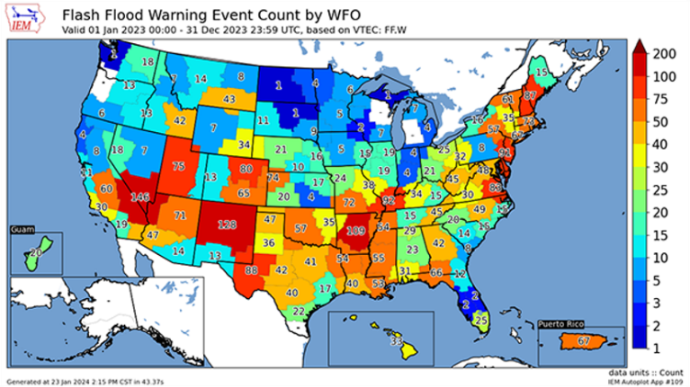
Flash Flooding is a National Issue
Flash Flooding Profile
  NWS Definition: Flooding that begins within 6 hours, and often within 3 hours, of the heavy rainfall (or other cause).
  Causes: Extremely heavy rainfall from thunderstorms, dam or levee breaks, mudslides (debris flow), and icejams or rapid snowmelt
  Dangers: Speed and force of water, debris, rapid rise, surprise factor
  Where: Urban and rural areas – including camps and campgrounds (Discussion: Why are camps and campgrounds susceptible?)
Three types of alerts:
Flash Flood Watch
Flash Flood Warning
Flash Flood Emergency (rare)
Notes:
Welcome to the Summer of Flash Flooding 2025! According to the Iowa Environmental Mesonet, almost 3,700 of these warnings were issued by the NWS in 2023. In that same year, only 29 flash flood emergencies were issued.

Slide 3
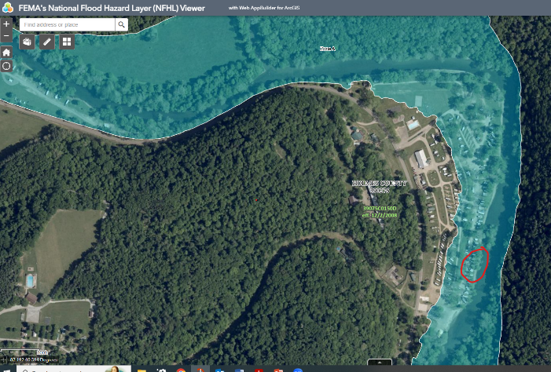
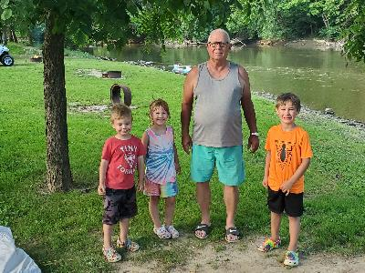
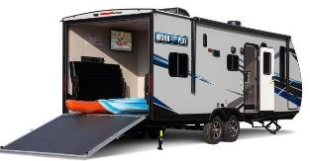
Flash Flooding is an Ohio Issue Too!
  Campgrounds and RV parks can be found throughout Ohio.
  Camping or recreating along streams or rivers can be a risk if there are thunderstorms in the area. A creek only 15 cm deep in mountainous areas can swell to a 3 m deep raging river in less than an hour if a thunderstorm lingers over an area for an extended period of time (NWS)
Wally World Riverside Resort and Campground on the Mohican River, Loudonville OH
Notes:
While these trends are getting worse, it is always good to remind everyone that not every disaster is declared….in fact, far from it….and that our personal resilience to flooding nationwide is not very high.

Slide 4
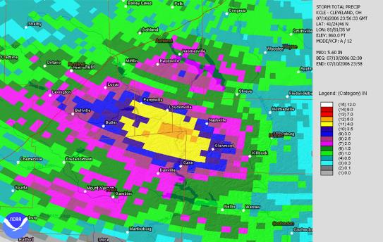
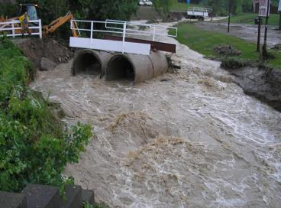
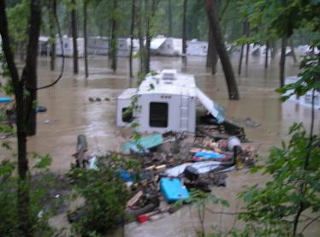
Flash Flooding is an Ohio Issue Too!
Mohican River, July 10, 2006
  Afternoon supercell thunderstorm developed and moved through Ashland County becoming nearly stationary near Loudonville in 4-corner region
  Up to 19 cm of rain in 2 hour period
  More than 700 people evacuated at Mohican State Park mostly by boat
  At least 15 roads washed out in the area
Photos of flood water in trailer parks along the Mohican River in Loudonville on July 10, 2006. Photos courtesy of Ashland and Richland County EMAs.
Notes:
While these trends are getting worse, it is always good to remind everyone that not every disaster is declared….in fact, far from it….and that our personal resilience to flooding nationwide is not very high.

Slide 5
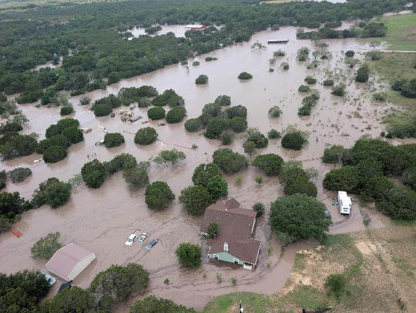
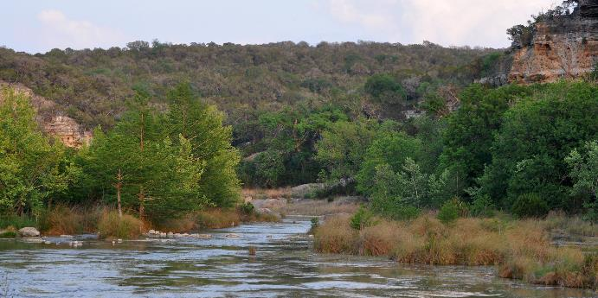
2025 Independence Day Flash Flood, Texas
Occurred in Texas hill country in an area known as Flash Flood Alley on the Guadalupe River
Guadalupe River has long history of deadly flash floods
138 deaths (119 of them in Kerr County)
$18 billion in estimated damages (flash flooding occurred in TX through 7/12)
Check out documentary “Flash Flood Alley” by Marshall Frech on Vimeo
By William L. Farr - Own work, CC BY-SA 4.0, https://commons.wikimedia.org/w/index.php?curid=91265742

Slide 6
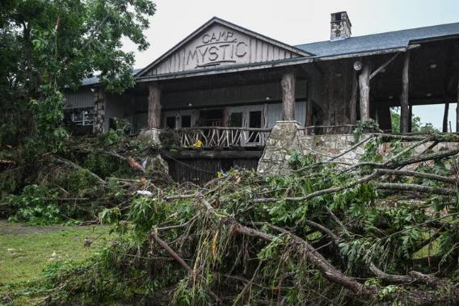
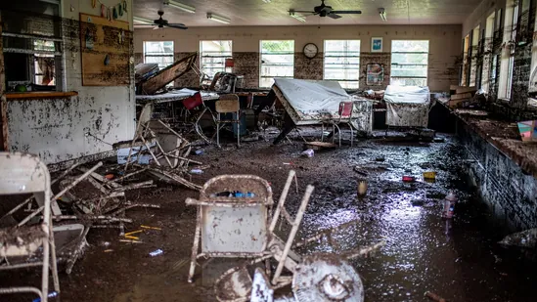
Camp Mystic Catastrophe
27 campers and counsellors died
Early warning had been provided by the National Weather Service: Flood Watch 7/3 @ 1:18PM, Flash Flood Warning 7/4 @ 1:14AM, Flash Flood Emergency @ 4:03 AM
Local warnings were not provided by Kerr County & there were no sirens in the vicinity of Camp Mystic
Camp Mystic is in a spotty cell phone reception area limiting delivery of wireless emergency alerts.
Notes:
1. There is a regulatory gap when it comes to campgrounds. NFIP minimum standards and most
community floodplain regulations only deal with development (i.e., turning a shovel full of dirt) and
typically not temporary residential/overnight uses in the floodplain like camping especially if a building
isn’t being constructed or improved. A zoning code may provide some use requirements or restrictions.
Although emergency management plans (EAPs) are best practices and most counties have a local
emergency management department which can provide technical assistance, they are not usually
required. And based on a cursory review of health department regulations while there may be both
state and local standards and inspection/licensure requirements, any requirements for emergency
procedures from a public health perspective are typically generic if they exist at all. Inspections tend to
be “check the box” on things like that the plan is posted, etc.
Local floodplain management ordinances could be improved to specifically address campgrounds. And
for consistency purposes, state model ordinances could have clarifying language.
2. Flood warnings, whether they be from sirens or from NWS alerts, are limited in effectiveness if you
don’t have a specific EAP to accompany it. A siren or a weather radio is not, by itself, an effective flood
warning system. To have an effective system – it is as important to have instructions or procedures to
take action after the warning, especially when time is limited such as a flash flood situation.
There has been a lot of social science research and new innovations on warning systems in the past 25
years. The Integrated Public Alert and Warning System (IPAWS) was created in 2006. It was established
by Executive Order 13407, which was signed on June 26, 2006. The order mandated the creation of a
more effective, reliable, and comprehensive system for delivering public alerts and warnings. FEMA was
designated as the lead agency for developing IPAWS in 2004. The Warning Lexicon was created in 2023
and is a tool designed to help risk communicators write effective warning messages, particularly for
Wireless Emergency Alerts (WEA), by providing a standardized set of statements about hazards, their
impacts, and recommended protective actions. It&#39;s based on research and a theoretical framework
called the Warning Response Model, which identifies five key elements of effective warning messages:
hazard, impacts, location, guidance, and time. The lexicon aims to improve the clarity, speed, and
effectiveness of warning messages by offering a common language and actionable statements for
various hazards. Page 37-39 of the Lexicon’s supplemental information has a warning message
framework for flash floods. A great background read on the Lexicon and the research / evolution of
flood warnings can be found here. Finally, DHS Science and Technology Directorate has had an effort
since 2016 focusing on the development and commercialization of low-cost flood sensors. A facts sheet
can be found here.
In short, the development of tailored flood warning systems (defined here as a network of technologies
and procedures designed to monitor and alert individuals and authorities about potential flooding,
allowing for timely response and mitigation efforts) has never been easier or more customizable to
specific situations than it is today.
3. EAPs for flash flooding in campgrounds are non-existent or insufficient. An internet review of several
available EAPs for campgrounds or RV parks shows a tendency for flash floods to be lumped in with
severe weather events. Flash flooding as a hazard must be broken out from generic severe weather
events and need to have automatic triggers and specific evacuation routes/points. For example, the
evacuation/shelter point for a tornado – the lowest part of a building for example – will get you killed in
a flash flood. In an informal review done on several EAPs for campgrounds and RV parks – while some
features of an effective EAP are present – there seem to be none that have all elements of what an
effective EAP should have. The General Camp Emergency Action Procedures for the Girl Scouts Rivers
Valley (Minnesota) has one of the better existing EAPs based on the internet review of available EAPs.
4. EAPs must be exercised with all responsible staff and campers so that it becomes automatic in the
case of an unexpected, middle-of-the-night event. Based numerous articles, it appears that in Camp
Mystic and nearby Camp La Junta the staff were not familiar (note: no article specifically said this – it is
a conclusion based on those articles).
One underutilized exercise approach that is core to emergency management and would seem to be
helpful here – either to develop or improve EAPs and/or to facilitate better awareness of the flood
hazard and EAP - is a tabletop exercise. A tabletop exercise (TTX) is a discussion-based simulation used
to evaluate and improve emergency response plans. It involves a facilitated discussion where
participants analyze a hypothetical hazard scenario, identify potential problems, and develop solutions,
all within a low-stress, informal environment. The development of a tabletop exercise focused on
campgrounds dealing with a middle of the night flash flood would seem to be helpful.
5. Parents are almost entirely unaware of a camp’s flood risk or whether or not a camp has effective
emergency plans. ASFPM participated in several interviews discussing this point including this one from
NPR. It is clear that not only should parents be more educated but by asking campgrounds the right
questions it will certainly prompt campground owners to ensure that their EAPs are updated and that
there is awareness of them.

Slide 7
Camp Mystic Catastrophe
According the flood hydrograph – the Guadalupe River rose over 7.6 meters in 2 hours between 3:00 AM and 5:15 AM
There appeared to be a delay in evacuations of up to 75 minutes at Camp Mystic after NWS flash flood warnings were issued
Based on interviews the Camp Mystic director conferred with employees how to respond to the alert and then the camp “descended into chaos as the floodwaters rose.”
On the afternoon of 7/3 and during the peak of the event 7/4 the county EM director was indisposed
Notes:
1. There is a regulatory gap when it comes to campgrounds. NFIP minimum standards and most
community floodplain regulations only deal with development (i.e., turning a shovel full of dirt) and
typically not temporary residential/overnight uses in the floodplain like camping especially if a building
isn’t being constructed or improved. A zoning code may provide some use requirements or restrictions.
Although emergency management plans (EAPs) are best practices and most counties have a local
emergency management department which can provide technical assistance, they are not usually
required. And based on a cursory review of health department regulations while there may be both
state and local standards and inspection/licensure requirements, any requirements for emergency
procedures from a public health perspective are typically generic if they exist at all. Inspections tend to
be “check the box” on things like that the plan is posted, etc.
Local floodplain management ordinances could be improved to specifically address campgrounds. And
for consistency purposes, state model ordinances could have clarifying language.
2. Flood warnings, whether they be from sirens or from NWS alerts, are limited in effectiveness if you
don’t have a specific EAP to accompany it. A siren or a weather radio is not, by itself, an effective flood
warning system. To have an effective system – it is as important to have instructions or procedures to
take action after the warning, especially when time is limited such as a flash flood situation.
There has been a lot of social science research and new innovations on warning systems in the past 25
years. The Integrated Public Alert and Warning System (IPAWS) was created in 2006. It was established
by Executive Order 13407, which was signed on June 26, 2006. The order mandated the creation of a
more effective, reliable, and comprehensive system for delivering public alerts and warnings. FEMA was
designated as the lead agency for developing IPAWS in 2004. The Warning Lexicon was created in 2023
and is a tool designed to help risk communicators write effective warning messages, particularly for
Wireless Emergency Alerts (WEA), by providing a standardized set of statements about hazards, their
impacts, and recommended protective actions. It&#39;s based on research and a theoretical framework
called the Warning Response Model, which identifies five key elements of effective warning messages:
hazard, impacts, location, guidance, and time. The lexicon aims to improve the clarity, speed, and
effectiveness of warning messages by offering a common language and actionable statements for
various hazards. Page 37-39 of the Lexicon’s supplemental information has a warning message
framework for flash floods. A great background read on the Lexicon and the research / evolution of
flood warnings can be found here. Finally, DHS Science and Technology Directorate has had an effort
since 2016 focusing on the development and commercialization of low-cost flood sensors. A facts sheet
can be found here.
In short, the development of tailored flood warning systems (defined here as a network of technologies
and procedures designed to monitor and alert individuals and authorities about potential flooding,
allowing for timely response and mitigation efforts) has never been easier or more customizable to
specific situations than it is today.
3. EAPs for flash flooding in campgrounds are non-existent or insufficient. An internet review of several
available EAPs for campgrounds or RV parks shows a tendency for flash floods to be lumped in with
severe weather events. Flash flooding as a hazard must be broken out from generic severe weather
events and need to have automatic triggers and specific evacuation routes/points. For example, the
evacuation/shelter point for a tornado – the lowest part of a building for example – will get you killed in
a flash flood. In an informal review done on several EAPs for campgrounds and RV parks – while some
features of an effective EAP are present – there seem to be none that have all elements of what an
effective EAP should have. The General Camp Emergency Action Procedures for the Girl Scouts Rivers
Valley (Minnesota) has one of the better existing EAPs based on the internet review of available EAPs.
4. EAPs must be exercised with all responsible staff and campers so that it becomes automatic in the
case of an unexpected, middle-of-the-night event. Based numerous articles, it appears that in Camp
Mystic and nearby Camp La Junta the staff were not familiar (note: no article specifically said this – it is
a conclusion based on those articles).
One underutilized exercise approach that is core to emergency management and would seem to be
helpful here – either to develop or improve EAPs and/or to facilitate better awareness of the flood
hazard and EAP - is a tabletop exercise. A tabletop exercise (TTX) is a discussion-based simulation used
to evaluate and improve emergency response plans. It involves a facilitated discussion where
participants analyze a hypothetical hazard scenario, identify potential problems, and develop solutions,
all within a low-stress, informal environment. The development of a tabletop exercise focused on
campgrounds dealing with a middle of the night flash flood would seem to be helpful.
5. Parents are almost entirely unaware of a camp’s flood risk or whether or not a camp has effective
emergency plans. ASFPM participated in several interviews discussing this point including this one from
NPR. It is clear that not only should parents be more educated but by asking campgrounds the right
questions it will certainly prompt campground owners to ensure that their EAPs are updated and that
there is awareness of them.

Slide 8
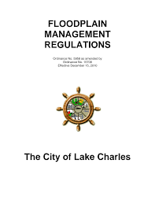
Finding #1: Regulatory/oversight gaps leave camps and campgrounds vulnerable
Typical floodplain regulations don’t do much, occasionally there are zoning standards. Most likely standard is through local or state health departments which tend to license campgrounds
The NFIP does not have minimum requirements for recreational vehicle parks or campgrounds other than the limitations on the placement of recreational vehicles
FEMA suggest that while such uses are good for floodplains where seasonal flooding occurs, they should not be permitted in flash flood areas (FEMA 480)
Consider prohibitions for new cabins/sites, land use standards for temporary or overnight occupancy on existing sites, requirements for warning systems/EAPs
Notes:
1. There is a regulatory gap when it comes to campgrounds. NFIP minimum standards and most
community floodplain regulations only deal with development (i.e., turning a shovel full of dirt) and
typically not temporary residential/overnight uses in the floodplain like camping especially if a building
isn’t being constructed or improved. A zoning code may provide some use requirements or restrictions.
Although emergency management plans (EAPs) are best practices and most counties have a local
emergency management department which can provide technical assistance, they are not usually
required. And based on a cursory review of health department regulations while there may be both
state and local standards and inspection/licensure requirements, any requirements for emergency
procedures from a public health perspective are typically generic if they exist at all. Inspections tend to
be “check the box” on things like that the plan is posted, etc.
Local floodplain management ordinances could be improved to specifically address campgrounds. And
for consistency purposes, state model ordinances could have clarifying language.
2. Flood warnings, whether they be from sirens or from NWS alerts, are limited in effectiveness if you
don’t have a specific EAP to accompany it. A siren or a weather radio is not, by itself, an effective flood
warning system. To have an effective system – it is as important to have instructions or procedures to
take action after the warning, especially when time is limited such as a flash flood situation.
There has been a lot of social science research and new innovations on warning systems in the past 25
years. The Integrated Public Alert and Warning System (IPAWS) was created in 2006. It was established
by Executive Order 13407, which was signed on June 26, 2006. The order mandated the creation of a
more effective, reliable, and comprehensive system for delivering public alerts and warnings. FEMA was
designated as the lead agency for developing IPAWS in 2004. The Warning Lexicon was created in 2023
and is a tool designed to help risk communicators write effective warning messages, particularly for
Wireless Emergency Alerts (WEA), by providing a standardized set of statements about hazards, their
impacts, and recommended protective actions. It&#39;s based on research and a theoretical framework
called the Warning Response Model, which identifies five key elements of effective warning messages:
hazard, impacts, location, guidance, and time. The lexicon aims to improve the clarity, speed, and
effectiveness of warning messages by offering a common language and actionable statements for
various hazards. Page 37-39 of the Lexicon’s supplemental information has a warning message
framework for flash floods. A great background read on the Lexicon and the research / evolution of
flood warnings can be found here. Finally, DHS Science and Technology Directorate has had an effort
since 2016 focusing on the development and commercialization of low-cost flood sensors. A facts sheet
can be found here.
In short, the development of tailored flood warning systems (defined here as a network of technologies
and procedures designed to monitor and alert individuals and authorities about potential flooding,
allowing for timely response and mitigation efforts) has never been easier or more customizable to
specific situations than it is today.
3. EAPs for flash flooding in campgrounds are non-existent or insufficient. An internet review of several
available EAPs for campgrounds or RV parks shows a tendency for flash floods to be lumped in with
severe weather events. Flash flooding as a hazard must be broken out from generic severe weather
events and need to have automatic triggers and specific evacuation routes/points. For example, the
evacuation/shelter point for a tornado – the lowest part of a building for example – will get you killed in
a flash flood. In an informal review done on several EAPs for campgrounds and RV parks – while some
features of an effective EAP are present – there seem to be none that have all elements of what an
effective EAP should have. The General Camp Emergency Action Procedures for the Girl Scouts Rivers
Valley (Minnesota) has one of the better existing EAPs based on the internet review of available EAPs.
4. EAPs must be exercised with all responsible staff and campers so that it becomes automatic in the
case of an unexpected, middle-of-the-night event. Based numerous articles, it appears that in Camp
Mystic and nearby Camp La Junta the staff were not familiar (note: no article specifically said this – it is
a conclusion based on those articles).
One underutilized exercise approach that is core to emergency management and would seem to be
helpful here – either to develop or improve EAPs and/or to facilitate better awareness of the flood
hazard and EAP - is a tabletop exercise. A tabletop exercise (TTX) is a discussion-based simulation used
to evaluate and improve emergency response plans. It involves a facilitated discussion where
participants analyze a hypothetical hazard scenario, identify potential problems, and develop solutions,
all within a low-stress, informal environment. The development of a tabletop exercise focused on
campgrounds dealing with a middle of the night flash flood would seem to be helpful.
5. Parents are almost entirely unaware of a camp’s flood risk or whether or not a camp has effective
emergency plans. ASFPM participated in several interviews discussing this point including this one from
NPR. It is clear that not only should parents be more educated but by asking campgrounds the right
questions it will certainly prompt campground owners to ensure that their EAPs are updated and that
there is awareness of them.

Slide 9
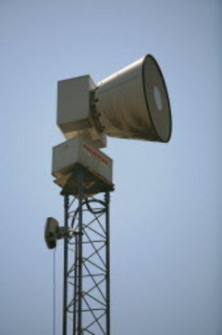
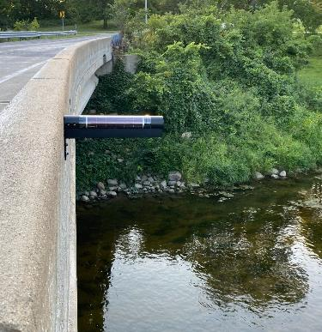
Finding #2: Advanced warnings only work when paired with action plans
Monitoring and warning devices do not, by themselves, constitute an effective warning system
They must be paired with procedures, and actions, and effective warning messages
Significant progress in past five years on low-cost flood sensors for monitoring and warning
Recent social science research resulted in the Warning Lexicon in 2023 – tool to help craft effective warning messages
Many ways to monitor and warn of flash flooding – from NWS weather radios to sophisticated flood sensors tied into a local warning system.
Notes:
The development of tailored flood warning systems (defined here as a network of technologies and procedures designed to monitor and alert individuals and authorities about potential flooding, allowing for timely response and mitigation efforts) has never been easier or more customizable to
specific situations than it is today.

Slide 10
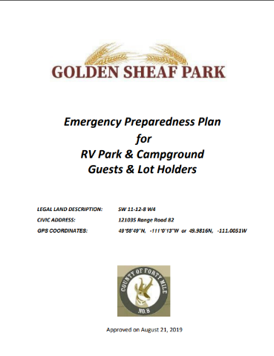
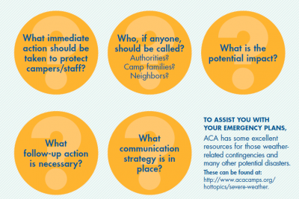
Finding #3: EAPs for flash flooding in campgrounds or RV Parks are non-existent or usually insufficient
May or may not be required as part of local/state permitting or licensing
County emergency managers can be of technical assistance provided they have the bandwidth to help
The American Camp Association (ACA) standard OM.8 requires that requires that a camp have site-specific emergency procedures established to appropriately respond to natural disasters typical of the area and other reasonably foreseeable emergencies.
If flash flooding was identified as a hazard, plans often too generic to be helpful or actionable (i.e. lump flash flooding with severe weather events)
EAPs for flash floods MUST, MUST, MUST be specific!
Notes:
The ACA, which stands for the American Camp Association, is the sole national accrediting body for organized camps in the United States. Only a subset of all campgrounds are accredited by the ACA. The accredit over 2,400 camps nationwide which represents about 25% of all camps.

Slide 11
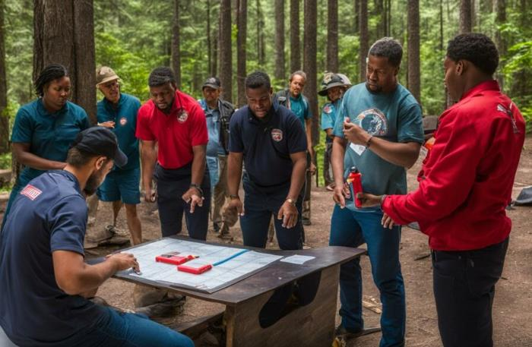
Finding #4: Plans must be practiced to be effective
Plan must be exercised with staff as frequently as necessary – consider rotating counselors.
What about exercising it with campers – and teach them something about flooding, floodplains and flood risks?
EAPs must be rote to the point responsible individuals could “do it in their sleep.” Delay could lead to death
Could tabletop exercises be helpful?
Notes:
The development of tailored flood warning systems (defined here as a network of technologies and procedures designed to monitor and alert individuals and authorities about potential flooding, allowing for timely response and mitigation efforts) has never been easier or more customizable to
specific situations than it is today.

Slide 12

Finding #5: Parents need awareness and to ask the right questions
What are the hazards that could impact the camp?
Is the camp in a floodplain, a floodway? What about the overnight accomodations?
What is are the specific procedures for flash floods? Where is the specific evacuation point?
Is there anyone charged with staying awake at night in the event there is a flood watch (i.e., a duty officer?)
Is the camp accredited by the ACA?
Photo credit: iStock/kali9
Notes:
The development of tailored flood warning systems (defined here as a network of technologies and procedures designed to monitor and alert individuals and authorities about potential flooding, allowing for timely response and mitigation efforts) has never been easier or more customizable to
specific situations than it is today.

Slide 13

Next Steps
Develop/adopt standards for camps, campgrounds and RV parks for floodplain management ordinances. State of PA is already considering updating their model ordinance. Texas is considering SB 1 to considerably strengthen oversight
Better coordinate with local/state health department to understand licensing requirements, work together
Develop a model EAP specific to flash flooding that camp owners can easily use either voluntarily or tied to ordinance/oversight requirements
Work directly with campground owners, ACA
Develop a tabletop exercise to drill Camp Mystic scenario and test EAPs
Develop a checklist for parents of campers of questions to ask
Notes:
The development of tailored flood warning systems (defined here as a network of technologies and procedures designed to monitor and alert individuals and authorities about potential flooding, allowing for timely response and mitigation efforts) has never been easier or more customizable to
specific situations than it is today.

Slide 14

Questions?
The broad problem of flood-loss reduction is that the rate at which flood losses are being eliminated by construction of engineering or land-treatment works is of about the same magnitude as the rate at which new property is being subjected to damage.
- Gilbert Fowler White
Notes:
Thank you for your participation, thank you for the work you do, and thank you for being on the front lines in fighting against our nation’s biggest hazard!

