Slide 1

T2-A2 Flash flooding case studies to improve predictions and the communication of uncertainty
Carla Mooney, David Wilke, Victoria Heinrich and Karen Hudson
Notes:
First of all, thanks for having us
David Wilke, talking today with Carla Mooney who is the manager of Social Science and Service policy team in the Decision Support Services program of CSG.
Talking about a social science research project that's looking at flash flooding, particularly how we communicate in flash flood events
Talking about the project, but particularly the engagement process with stakeholders, which has been done through NHRA, and has been an important feature of the research

Slide 2

NHRA Rain/Flood projects
Project 1 – Flash flooding case studies to improve predictions and the communication of uncertainty
What works well in the current service? What doesn't?
Project 2 – Developing an integrated predictive capability for extreme rainfall and inundation
Project 3 – Long Range Flood Outlook for Strategic Preparedness
How can we improve lead time?
How can we better use existing forecast information to improve predictions and communication?
Three distinct but related Bureau / NHRA projects considering heavy rainfall and its impacts.
Work to improve predictions, lead time and the communication of risk.
Notes:
First some background on NHRA and the related projects that we have in the Bureau.
NHRA, or Natural Hazards Research Australia, is our national centre for natural hazard resilience and disaster risk reduction
It follows from the old BNHCRC.
It was funded by the Australian Government in July 2021 for 10 years as a collaborative research organisation
Looks at bushfires, floods, cyclones, heatwaves, storms and other hazards.
The aim they have is to deliver usable research that improves community safety and resillience, it's very applications focussed,
In the Bureau we have a number of projects part-funded by NHRA.
There are several fire projects building on legacy of BNHCRC engagement
But in the last year we've started three rain and flood projects which together are conducting work to improve predictions, lead time and communication of risk around flood hazards.
The first project is what Carla and I will be talking about today, this is a social science project focussed on communication
Really looking to determine a baseline for our current service.
The other two projects are work that is being led in SIG.
The second project is a larger project led by Paul FH which is looking at a future predictive service for rain and inundation.
This is a collaborative effort across Radar, Hydrological teams exploring how we improve predictions and communication to EM.
The third project is looking at the long range flood outlook, led by Wendy with Navid and Chris Pickett Heaps
This work is hoping to help emergency services plan at longer timescales
AFAC have their own plan for a seasonal outlook. This project aims to inform this work.
These projects are working together.
We're going to be talking about the first project today. I'll provide some more background and then Carla will provide some more detail on the results and how we engaged stakeholders
---------------------------------------------------------------
---------------------------------------------------------------

Slide 3
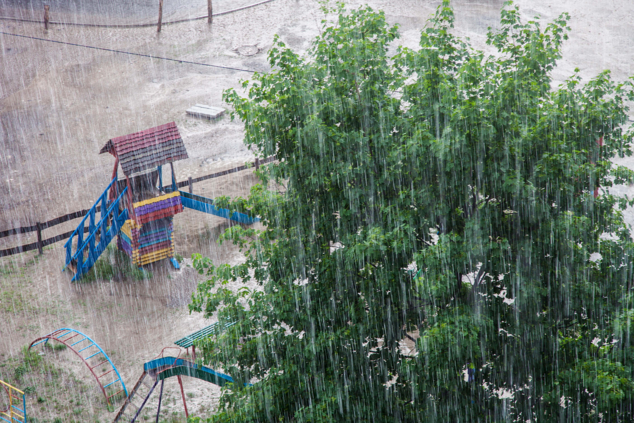
What is flash flooding?
"Flooding of short duration with a relatively high peak discharge in which the time interval between the observable causative event and the Flood is less than six hours."
... and how is it warned for?
The prime responsibility for flash flood warnings lies with States and Territories through local councils.
The Bureau provides forecasts and warnings for heavy rainfall that may lead to Flash Flooding.
© Shutterstock/Vadym Zaitsev
Intergovernmental Agreement On The Provision Of Bureau Of Meteorology Hazard Services To The States And Territories
Notes:
- What is flash flooding?
- FF is rapid flooding of short duration that occurs within 6hr of causative event.
- Due to a range of causes, most commonly rainfall (the focus of this study), but also dam breaks and in some cases snow melt.
- Influenced by a range of factors (e.g. topography, soil moisture),
- For this reason it is very difficult to predict and there is often high uncertainty.
- So, Bureau issues warnings for rainfall that may lead to flash flooding.
- S/T have primary responsibility for flash flood warnings, but this is often not possible with sufficient lead time.
- It is a complicated arrangement that varies by jurisdiction
- To identify strategies to improve we need to understand the various actors and the information they are using, or producing.
---------------------------------------------------------------
---------------------------------------------------------------
From IGA:
that prime responsibility for flash flood warnings lies with States and Territories through local councils
the Commonwealth’s responsibility in relation to Flash Floods is for the Bureau to provide forecasts and warnings for severe weather conditions and potential heavy rainfall conducive to Flash Flooding and to carry out applied research and development to improve the provision of severe weather information (e.g. areal, intensity and timing).
All levels of government will collaborate in preparing the community for the
potential of Flash Flooding, which by its nature may not allow sufficient lead time
for site specific warnings and forecasts;

Slide 4
Study questions
Study approach
Is ‘flash flooding’ well understood by the community and emergency services?
Is the uncertainty around the forecast communicated effectively?
Is the fidelity of information changed as it passes between agencies and to the public?
Is the balance between lead time and uncertainty right?
Quantitative survey to establish baseline
Case study analysis
... how does this affect community response?
Notes:
To look at these study questions we have two main modes of inquiry
we developed a survey for both the public and EM which aim's to determine a baseline of understanding and help us answer those first two questions (And we will provide some results toward the end of the talk)
And the second mode is a case study analysis which we'll talk about first
This is really about looking at existing information, what happened when, and helping to understand how information flows in an event

Slide 5
Flash Flood Case studies using a value chain approach
Key Actors
Bureau of Meteorology
Local Government State Government; State emergency services; Police Infrastructure owners/operators
Via radio, websites, press conferences, television, text and phone messages, emails, social media, sirens/alarms
Unofficial or personal forms of communication – word of mouth, social media
Households and individuals, businesses, local and state governments, State Emergency Services, Police
Responsibilities
Case studies describe the end- to-end warning value chain to help understand where the system is not meeting the needs of users
Mixed methods
Multi-disciplinary
Collaborative
Weather forecasts and warnings
Interpretation of weather forecasts and warnings
Warning construction
Rapid assessment to rank how well parts of the value chain performed
Warning communication
Warning Value Chain Questionnaire and Guide
Further dissemination
Response
Notes:
- A really good way to interrogate the flow of information is the value chain approach
This is the outcome of some research conducted through the WMO's High Impact Weather project
Carla, Beth Ebert and David Hoffman have worked as part of an international collaboration on this
The real benefit of this approach is it allows us to examine links in the chain and identify where value is being created and also where we're losing fidelity of information
For a hazard like flash flood, with the complicated warning arrangements that we have, its perfect
The Case study analysis that we used, that Carla will now talk about was based around this method.

Slide 6
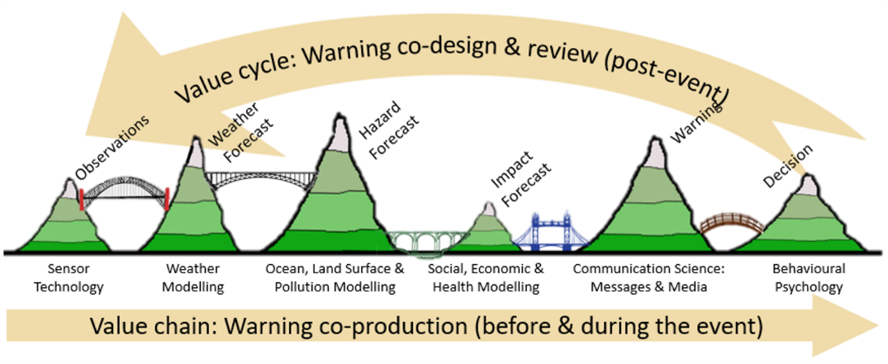



Value Chain Project / Approach
Warning Value Chain Questionnaire and Guide
Notes:
A really good way to interrogate the flow of information is the value chain approach
A sequential value chain is a useful foundational framework for analysis. It is possible to analyse each node for its information generation, quality and value addition and pinpoint areas for improvement.
The real benefit of this approach is it allows us to examine links in the chain and identify where value is being created and also where we're losing fidelity of information
For a hazard like flash flood, with the complicated warning arrangements that we have, its perfect

Slide 7
The communication challenge
Survey public and emergency management about their understanding of flash flooding and certainty around its occurrence.
Evidence the public do not have a strong understanding of flash flood and contributing factors.
Research has shown words like possible, probable and chance have different meanings to the public, meteorologists and emergency managers.
Uncertainty in rainfall
Quantifiable
e.g. via weather models etc
Uncertainty in flash flooding
often not quantifiable
Influenced by factors at a specific location
Notes:
- This is an example of how forecast uncertainty is currently communicated in our warnings to the public.
- Rephrased: Heavy rainfall is possible. Flash flooding may occur.
- We talk about two kinds of uncertainty here:
- the uncertainty in the rainfall, which is quantifiable in the sense that we have methods to determine how likely it is, for example from ensembles.
- But we also talk about the uncertainty in the flash flooding, which is not quantifiable. We know that it depends on a range of factors but we don't know at a given location what is most relevant for a person.
- Whether a person believes they are at risk of flash flooding requires them to have knowledge of additional information.
- There is evidence, however, that the public do not have a strong understanding of flash flood and the factors that contribute to its occurrence.
- Furthermore, we also know that words like possible, probable and chance have different meanings to the public, meteorologists and emergency managers.
---------------------------------------------
---------------------------------------------
Accurate information to inform the community of the likelihood of flash flood in a specific location depends on the sharing of information between agencies in tight timeframes that may be unrealistic
The communication challenge may require response that includes better communication of quantifiable uncertainty and awareness raising and improved messaging about the factors that influence the potential of flash flooding
The case studies of flash flood events will look at how effectively quantifiable uncertainty is communicated across the end-to-end warning value chain
The survey of public will look at how well the factors that influence flash flood occurrence are known and how well the current language of quantifiable uncertainty in severe weather warnings is understood by respondents.
Psychosocial research shows that people have different definitions of words like possible, probable and chance (WMO)
Workshops and case studies aim to understand the communication pathways between technical / science advisors / forecasters (information providers) and operational decision-makers like responding agencies (e.g., emergency management) and support organisations, and the public (warning response)

Slide 8
Case study approach
Nomination of case studies
Desktop review and analysis
1:1 interviews with key players
Workshops to discuss and refine
Cross-case study comparison
Notes:
The case studies were nominated by project stakeholders who considered the event to be notable and warranting closer examination. The support of key stakeholders for the research was critical given the collaborative nature of the study method.
The events were also selected to cover a broad range of flash flood event types in Australia.

Slide 9
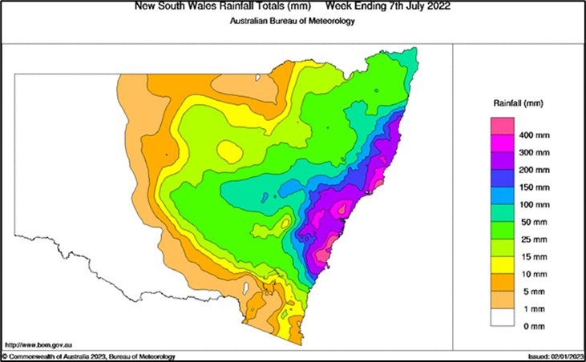
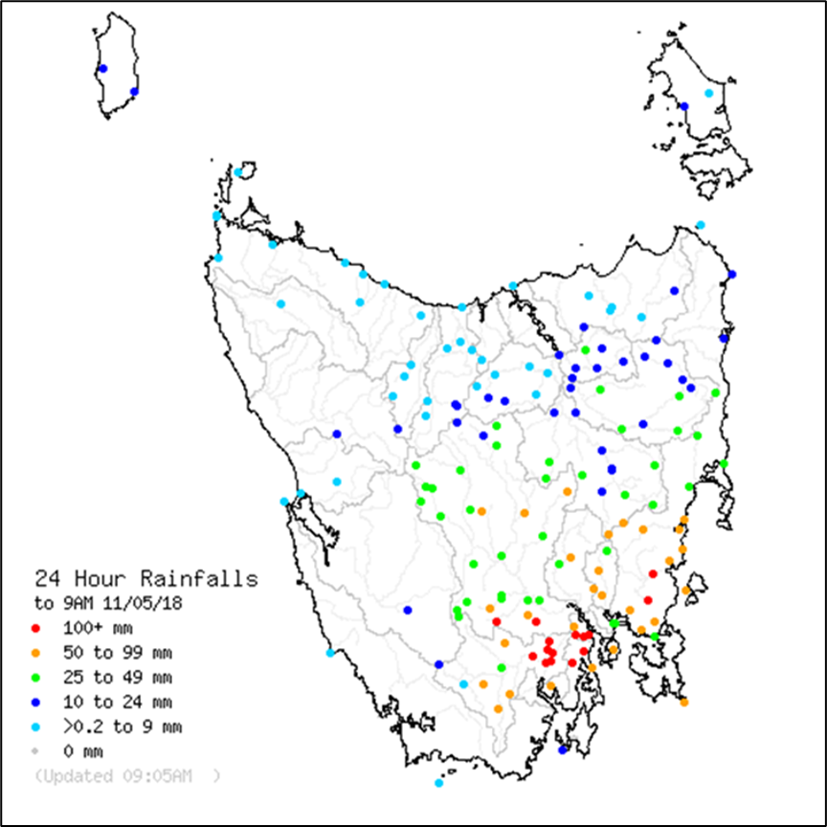
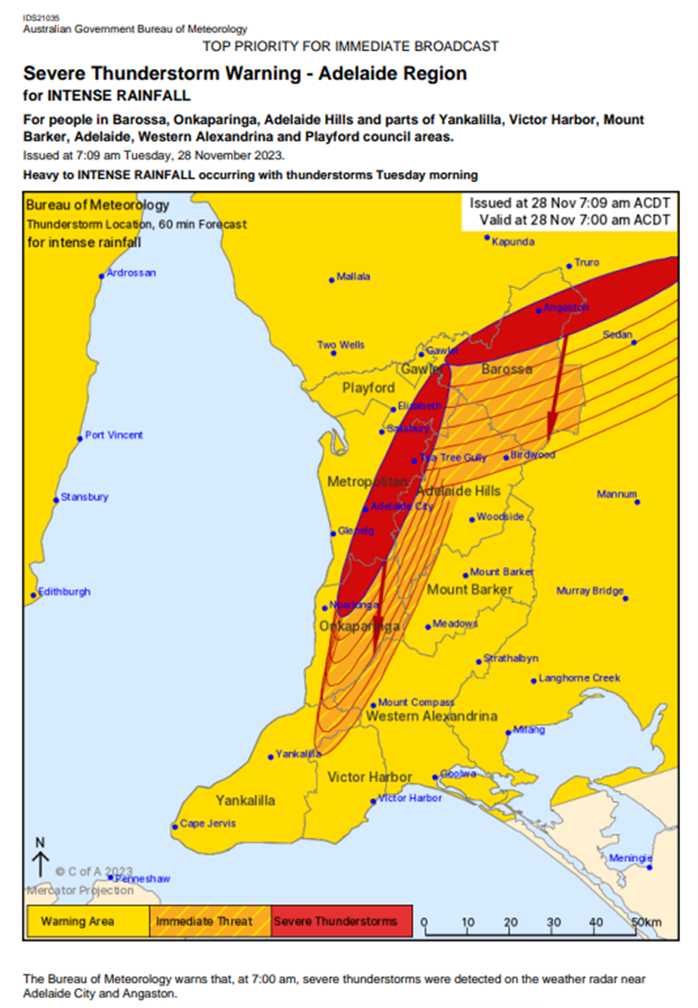
Flash Flood : Case studies
Case study 1 – Wallis Creek, NSW, July 2022
High impact, rare, multiple days
East Coast Low
Widespread flash flooding and isolations
Case study 2 - Hobart, TAS, May 2018
High impact, rare, short-duration
Severe thunderstorms
Extensive urban flash flooding and destruction
Case study 3 - Adelaide, SA, November 2023
Lower impact, more common, short-duration
Severe thunderstorms
Significant urban flash flooding
Notes:
Outline three cases at high-level
Wallis Creek, NSW - July 2022
A high impact, relatively rare event extending over multiple days.
Hobart, Tas - May 2018
A high impact, relatively rare event of short-duration.
Adelaide, SA - November 2023
A comparatively lower impact, more common event of short-duration
Wallis Creek - In July 2022, the Wallis Creek catchment in the Hunter Valley region of New South Wales (NSW) recorded significant flash flooding resulting from the passage of an East Coast Low. The flash flooding, which occurred within a larger rainfall and flood event impacting eastern NSW, caused numerous impacts across the region. This included extensive property damage and resulted in more than 5,000 people being isolated for up to 12 days in the Maitland local government area (LGA). The event was marked by various factors that contributed to significant uncertainty. These included initial model variation in the forecast rainfall, limited observations within the catchment area, complex interactions between riverine and flash flooding, and concerns regarding the structural integrity of Maitland's main levee system.
Hobart - During the evening of Thursday 10th May 2018 and overnight into Friday 11th May, severe thunderstorms brought intense rainfall across the Hobart area, causing widespread flash flooding and destruction. The worst affected areas were the southern suburbs of Hobart and the elevated areas directly inland. Total estimated losses attributable to the event were greater than $135 million, with extensive damage to bridges, roads, buildings and other infrastructure and significant agricultural impacts including stock and crop losses.
The event was challenging due to its rarity and volatility, significantly hampering preparedness and response activities. The previous similar flooding event in Hobart occurred in 1960, therefore the community memory of the potential impacts of extreme rain events was considerably diminished. In addition, the location and intensity of the heaviest rain was not well modelled, resulting in limited warning time ahead of impacts occurring. It was a tricky situation, not suggested by the guidance, with flash flooding initially considered a lower probability than damaging winds.
Adelaide - During the early morning of Tuesday 28 November 2023, the Adelaide CBD and surrounding areas experienced very heavy rainfall from thunderstorms causing widespread flash flooding and storm damage. This area is susceptible to flash flooding and is often impacted during heavy rainfall, at thresholds below those used by the Bureau for issuing warnings (2% AEP for heavy rainfall; 1% AEP for intense rainfall).
Key challenges during this event were the rapid development of storms, a succession of severe thunderstorm warnings issued (at unsociable hours and with no/limited ability for response), and the fact that this was urban flash flooding in a highly populated area and occurred during the morning rush-hour.
The event was caused by a complex weather system, being a cut-off low, which brought higher uncertainty than usual in the rainfall totals and areas of impact. It was also unusual in that the weather pattern was from the northeast rather than the more common pattern of moving across from the west. This added to the uncertainty and resulted in the SES not being confident enough to provide public warnings ahead of the event.

Slide 10
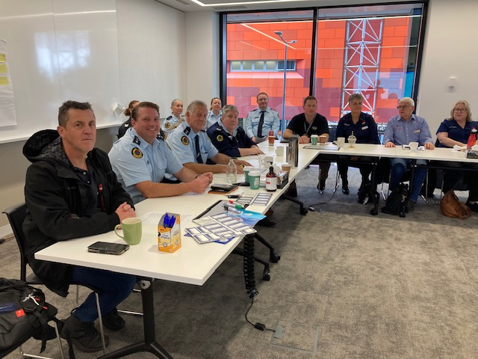
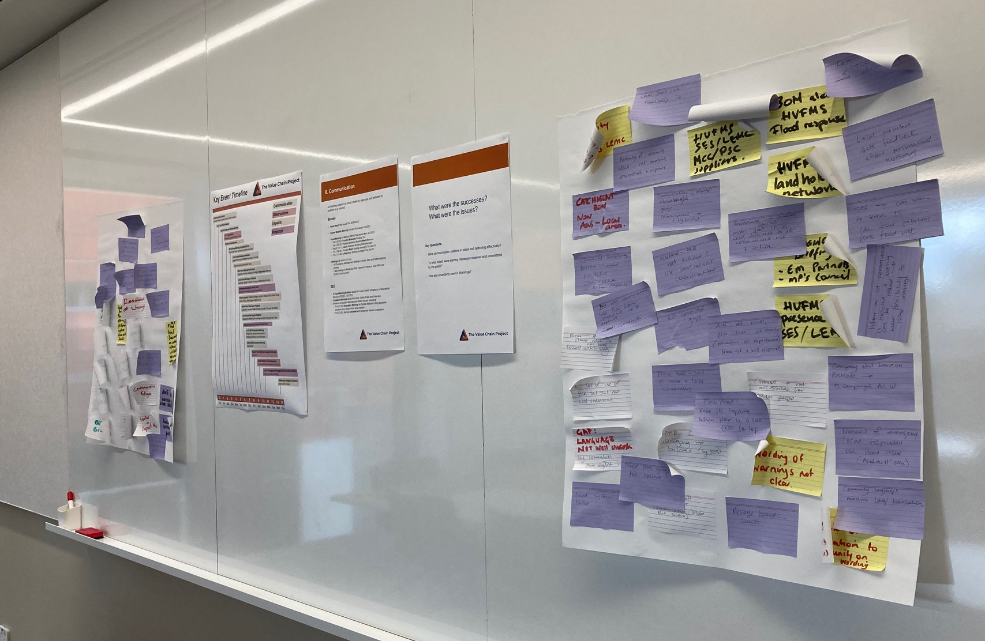
Stakeholder Workshops
In-person workshops held during July 2024
Attendance from a range of agencies including:
  SES, Local government, State government
  Police, Utilities, Flood Mitigation/Stormwater teams
  Bureau
Workshops followed a semi-structured approach
  Combination of presentations, discussion and small group activities
  Knowledge sharing and two-way conversation
  Discussing issues and opportunities

Slide 11
Value chain scoring
Workshop participants considered each component of the value chain
Performance scored using a qualitative scale - of 1 (poor) to 5 (excellent)
How well do you think the event was observed?
How well do you think the weather was forecast?
How well do you think the hazards were forecast?
How well do you think the impacts were predicted?
How well do you think warnings were communicated?
How well do you think the warnings were used?
How well do you think the entire warning value chain performed overall?

Slide 12
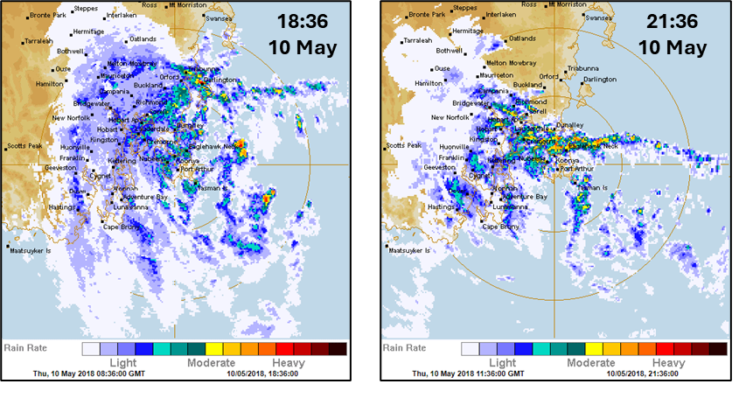
How did the components perform?
Observations
e.g. rain gauge, water level, satellite, radar
Input to weather models, also used for situational awareness
Coverage is patchy
Highest ranked
Radar was vital in the Hobart 2018 storm.
Obs
Weather
Hazard
Impact
Warnings
Response
12
Notes:
Rather than look at each individual case study in detail, we're going to consider a generalised summary for each value chain component
In this way we can examine the typical function and performance of each component and see how and where uncertainty plays a role
Starting with observations:
Key observations in flash flood events are rain gauge, water level but also importantly radar and satellite observations.
Initial role in the value chain is as input to weather models to drive forecasts
But obs also have a critical role later on for situational awareness and are important in warning and response.
Obs coverage is patchy across Australia, which introduces uncertainty
But coverage is better in high population areas.
It ranked highly in our case studies – in fact it was the highest ranked
This is likely because the case study regions had good coverage with little tech issues during the events
But there are some notable gaps
for example, in Wallis Creek there is no rated flood gauge.
In general, obs performed well.

Slide 13
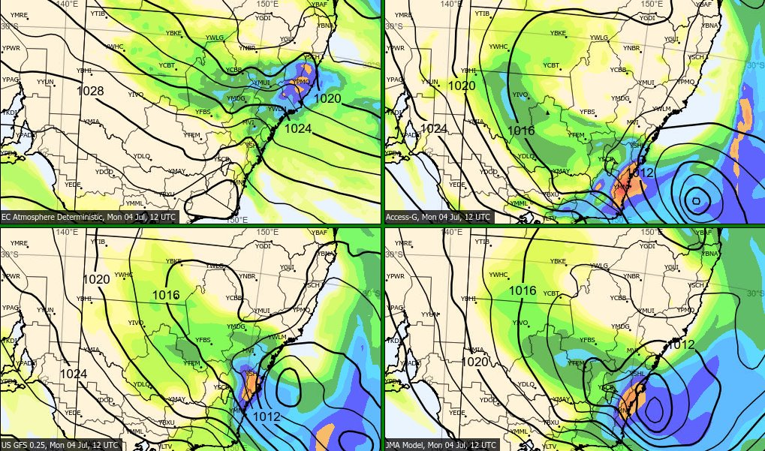
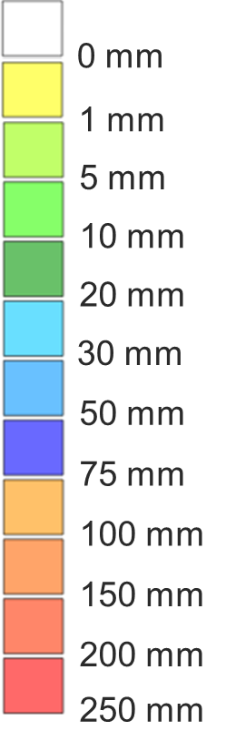
How did the components perform?
Maitland, NSW
Weather Forecast
e.g. NWP rainfall forecasts
Inform warning and response strategies
Can be used to quantify uncertainty, but rarely predict extremes accurately
High variation in rainfall forecasts during the Wallis Creek flood had flow-on effects
'Average'
Obs
Weather
Hazard
Impact
Warnings
Response
13
Notes:
For the weather forecast:
In flash flood events these are generally NWP forecasts of rainfall.
These are often significant intelligence to inform warnings and response strategies.
Often provide first indication that flash flooding may occur
Models can be used to quantify uncertainty, esp. ensemble rainfall forecasts which give a spread of potential outcomes
But current models rarely predict extreme rainfall accurately
This was true in each case study – in all events there was some indication that heavy rainfall could occur but it was not possible to say with confidence where it would occur or how much would fall.
The component was scored average for all cases
It was deemed valuable intelligence as a 'heads up', but in no instances did it accurately pick the events and left significant uncertainty for warnings and response

Slide 14
How did the components perform?
Hazard Forecast
Impact Forecast
e.g. flash flood extent, inundation, water level
e.g. structure damage, road closures, isolations
Can be a powerful tool to determine impact
Inform warning and response strategies
Only available for a few locations in Australia
Little capability in Australia
'Poor - Average'
Lowest ranked
Obs
Weather
Hazard
Impact
Warnings
Response
14
Notes:
The third and fourth components of the chain are the Hazard forecast and Impact forecast
Translating heavy rain forecasts into potential impact.
These two were consistently found to be the weakest points in the chain
This is because there was very limited capability for forecasting flash flood, or it's impact in each case study
And this is true in general across the country
Typically, there is a reliance on local knowledge of past events to determine what the impact might be
Having said that, there are a handful of locations with flash flood warning services (e.g. Paramatta and Townsville).
However, in the case study events considered, these two ranked lowest because the capability is the least mature.

Slide 15
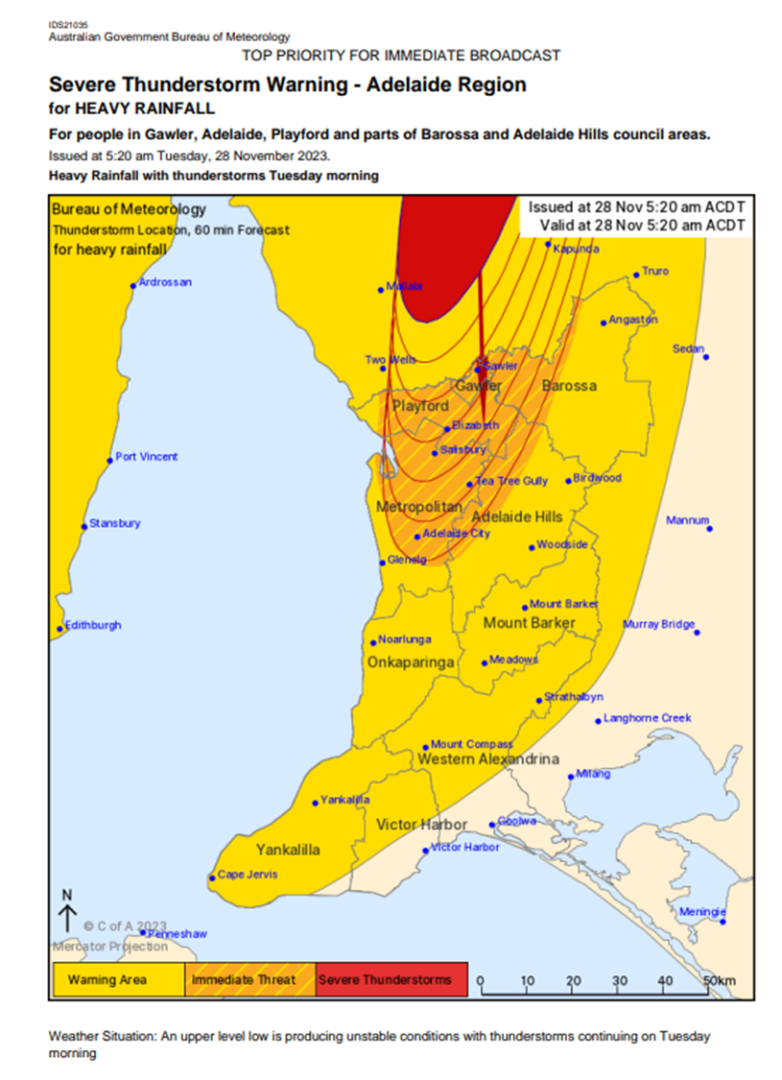
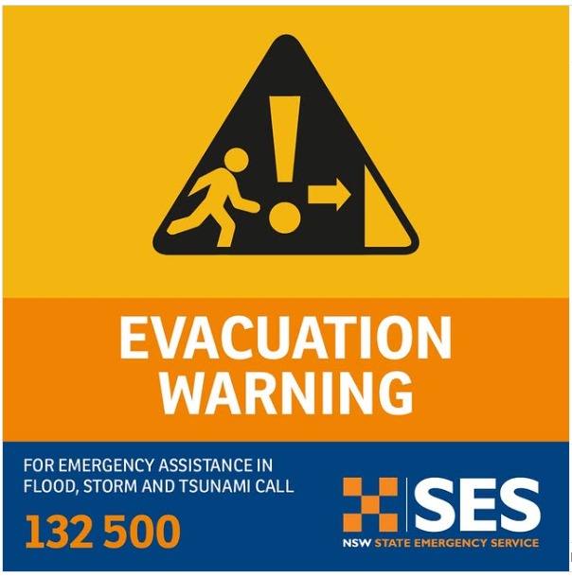
How did the components perform?
Warning / Comms
e.g. Severe Weather Warnings, Evacuation Warnings, public info
e.g. Severe Weather Warnings, Evacuation Warnings, public info
Inform response
Often reactive with little lead time
'Average to Good'
Obs
Weather
Hazard
Impact
Warnings
Response
15
Notes:
Looking now at how Warnings were communicated
When we talk about Warnings we're generally talking about:
Information from the Bureau like the SWW or STW
Or information from EM like evac warnings, orders
All case studies pre-dated AWS and it was noted in each case that AWS had brought substantial improvements, so further case studies may be necessary at a later date to help explore the updated warning landscape.
Generally Warnings in flash flood are reactive, and often do not provide much lead time for appropriate response which leads to issues and uncertainty further down the chain,
But, despite this, in our case studies warnings were generally seen as performing well
All events had warnings issued prior, there was significant communication done around the events to push the message out
But there are some notable issues, particularly with language that's used in warnings, which we will touch on shortly

Slide 16
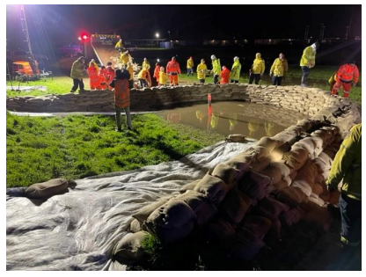
How did the components perform?
Response / Decision
e.g. sandbagging, road closures, evacuations, flood rescues
Aim to protect life and property
Often reactive
A possible Levee breach at Maitland Showground (ring Levee) required a section to be sandbagged (courtesy NSW SES).
Mixed performance
Obs
Weather
Hazard
Impact
Warnings
Response
16
Notes:
The final component of the VC is the response:
About actions to protect life and property like sandbagging, road closures, but also evacs and flood rescues
As with Warning communication, response was also found to be reactive,
But how performance was rated varied across studies:
Highly successful in Wallis (ranking equal first), but relatively low in the other.
This is likely because the Wallis Creek event had a longer perceived lead time (despite sig uncertainty in forecast), while the other events occurred with shorter lead time and there was little time to react to warning information.
- Also important to note that in the Wallis Creek event there was significant community response.
- the community in Gillieston Heights banded together to get through 9 days of isolation
- This likely contributed to the higher rating

Slide 17
Uncertainty is endemic
Maitland, NSW
In flash flood we need to live with uncertainty
It affects all components of the chain individually, but there are also flow-on effects
The challenge is to effectively communicate uncertainty
High variation in rainfall forecasts during the Wallis Creek case study had flow-on effects
"HEAVY RAINFALL which may lead to FLASH FLOODING is forecast to continue ... Six-hourly rainfall totals between 70 to 120 mm are possible."
Severe Weather Warning text from the Wallis Creek event
17
Notes:
What do we take out of these case studies in terms of uncertainty?
What we probably already knew: uncertainty is endemic across the value chain.
It affects all components individually to varying extents, and there are flow-on effects where uncertainty factors cascade from one component to another.
For example:
We have uncertainty in how much rain will fall
Then how the landscape will respond to the rain
How infrastructure will hold up
And finally how the community will react
And at each stage uncertainty factors grow and accumulate
So uncertainty, is endemic, the challenge is to effectively communicate uncertainty
How well do we do this?
Possibly not that well.
For example, a Severe Weather Warning issued by the Bureau during the Wallis Creek event:
HEAVY RAINFALL which may lead to FLASH FLOODING is forecast to continue ... Six-hourly rainfall totals between 70 to 120 mm are possible."
So the big question is:
Does the meteorologist who issues the warning
The EM personnel who receives it,
And the community member who reads it,
All have a shared understanding of what this means?
To help answer this question, Vicki will talk about the survey that was run.
Image: 24hr rainfall forecast July 4 at day 6 lead time.

Slide 18
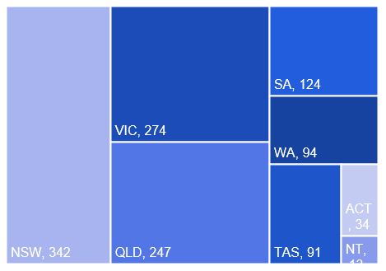
The Severe Weather and Heavy Rain Survey
Aim: A baseline assessment of the public and emergency management understanding of flash flooding and certainty around its occurrence.
N = 1235
Notes:
Is ‘flash flooding’ well understood?
Is uncertainty terminology well communicated?
Participation was anonymous, voluntary. Average of 16 minutes to complete.
Survey questions examined:
Perceptions and knowledge of flash flood.
Protective actions.
Experience.
Comprehension of warning messages.
Information preferences.
Survey was open from 22 February to 13 May 2024
Participants were over 18 years and recruited through word of mouth, the NHRA newsletter and the BOMIdeas mailing list which includes people who have volunteered to participate in Bureau research
A total of 1235 participants, 31% associated with the emergency services sector, 69% members of the Australian community classified as lay people for this study. Of the participants, 55% has experienced some form flooding, 38% in an urban environment, 31% in a rural setting. No further demographic information was collected.

Slide 19
'Flash flooding’ is not well understood
  83% selected - correct - Flooding of short duration and a relatively high flow
  27% selected – incorrect -Flooding that cannot be forecasted
  90% selected – correct - Short bursts of heavy rainfall such as from thunderstorms
  68% selected – incorrect –Storm surge or king tides
Participants knew some definitions and causes of flash flood.
However, they also held incorrect knowledge and misconceptions
Flash flood is?
What leads to flash flooding?
  94% selected – appropriate - Avoid rivers, creeks, drains or low-lying areas
  88% selected – appropriate - Check for advice and updates from emergency services, radio station
  86% selected – appropriate - Move to higher ground, or stay on high ground
  17% selected - less desirable - Wait for more information
Protective actions… you should:
The difference between 'Heavy' and 'Intense' rainfall is:
  67% selected - correct - Over the same time period, intense rainfall corresponds to a greater amount of rainfall
  63% selected – incorrect - Intense rainfall occurs over a shorter time period than heavy rainfall
Notes:
'Flash flooding’ is not well understood. We found that generally the level of knowledge is low. People know some factors, but are not aware of the specficis
e.g.,
People overestimated how much they know about flash flooding.
Contrary to our hypothesis, there is not much difference in knowledge of flash flooding between the emergency management (EM) and the public.

Slide 20
Flash flood risk factors
How important do you think each of the following is in determining the risk of flash flooding at a given location?
All these factors influence flash flood risk – some are not well known
Notes:
Knowledge of local risk and environmental factors that may lead to flash flooding was low. Most knew that the amount of rainfall in 24 hours was important, but factors like how built up an area is or the amount of rain over the last month that are also important in assessing flash flood risk were seen as less important
There were differences in EM and public, and flood experienced and inexperienced group perceptions of the importance of different flash flood risk factors.
People linked the amount of rain in the last 24 hours to the occurrence of flash flood but were less likely to consider the amount of rain the last month.
Significant differences for with EM rating slightly higher:
Amount of rainfall over the past month 2
How built-up or urbanised an area is 3
How steep or flat the land is 4

Slide 21
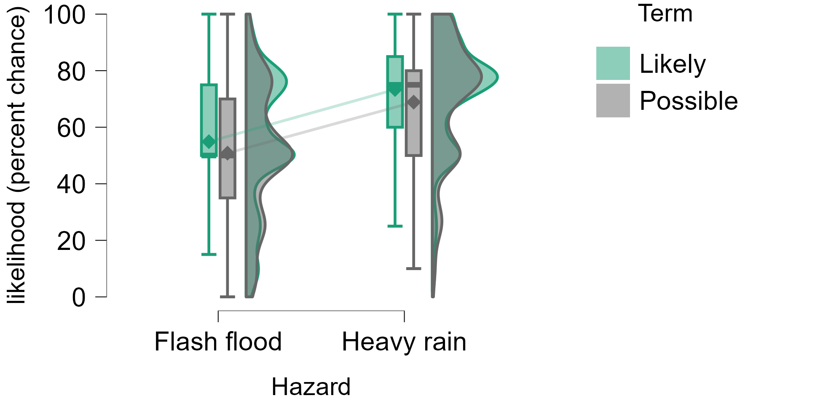
Uncertainty: Possible vs Likely
Is uncertainty terminology well communicated?
In general, no.
Terms, such as 'likely' or 'possible’, are understood differently
Responses for likelihood of occurrence are context dependent and related to the wording in the warning and event type
Warning message:
Heavy rain which may lead to flash flooding is possible/likely.
What do you think the likelihood (percent chance) of heavy rain/flash flooding is?
Notes:
You receive the following warning message for your location: HEAVY RAIN which may lead to FLASH FLOODING is possible/likely. What do you think the likelihood (percent chance) of HEAVY RAIN/FLASH FLOODING is?
Overlap in the ranges of likely and possible
Likely was more certain
Likely
Flash flood M = 55%
Heavy rain M = 73%
Possible
Flash flood M = 51%
Heavy rain M= 69%
As hypothesised, people had different understandings of the uncertainty terms such as likely and possible.
Responses for likelihood of occurrence are context dependent and related to the wording in the warning and event type.

Slide 22
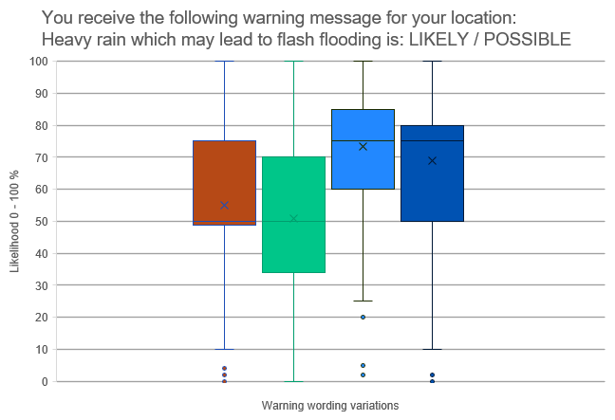
Two scenarios: How likely is Flash Flooding?
WMO Forecast Likelihood Scale
Recommended definitions of most common uncertainty terms
Likely –
70% to 89% probability
Likely
Heavy rain
Possible – less likely than not
30% – 44% probability
Likely
Flash flood
Possible
Heavy rain
Possible
Flash flood
There are clear issues with the current wording
Notes:
Is uncertainty terminology well communicated?
As hypothesised, people had different understandings of the uncertainty terms such as likely and possible.
The box plots on the figure represent the spread of people's responses (% Chance/likelihood) for each questions.
The values given varied between individuals, depending if the warning used the term likely or possible and if people were asked about the chance of occurrence of a flash flood or heavy rain.
Participants indicated 'likely' and 'possible' as meaning anywhere between a range of 0-100%
WMO Forecast Likelihood Scale Likely equal 70% to 89% probability (Likelihood of the occurrence/outcome); Possible – less likely than not 30% to 44% probability
Verbal probabilities are fuzzy – that is verbal probabilities less clear in their meaning and people interpret them differently.
Likely and possible have different percent chance or likelihood values and this changes with the context in which the terms are used (as shown in our data and other studies/research).
However, people do make better decisions when uncertainty information is available compared to when it is omitted (Joslyn & LeClerc 2008), therefore it may be a matter of better expressing uncertainty information in our warnings and forecasts for example by using predictive intervals (ranges) and educating people about their use.
Lishitz & Strauss, 1997,showed that decision makers distinguished among three types of uncertainty: inadequate understanding, incomplete information, and undifferentiated alternatives
To these they applied five strategies of coping (with uncertainty): reducing uncertainty, assumption-based reasoning, weighing pros and cons of competing alternatives, suppressing uncertainty, and forestalling.

Slide 23
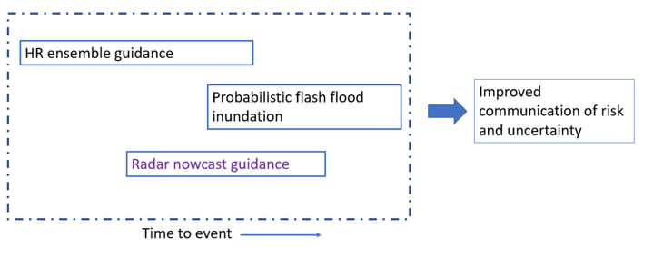
The case studies have identified a range of areas for potential improvement
Rainfall forecasts
Observations
Hazard forecasts
Warning construction
Warning communication
Flows of information
The survey has confirmed that current uncertainty language is not well understood
Quantifiable uncertainty
Unquantifiable uncertainty
Project 2 : Integrated predictive capability for extreme rainfall and inundation
Improve predictions of heavy rainfall
Identify locations at risk of flash flooding and inundation
Contact: paul.fox-hughes@bom.gov.au
Improvements in practice have occurred since the case study events
Warning communication
Administrative arrangements
Local flood intelligence
Notes:
Weather forecasts and hazard forecasts – Paul's project – looking at that part of the value chain

Slide 24
The communication challenge
Many steps, many actors
Uncertainty is unavoidable
Specific issues
The quality of information is shaped, limited or improved by the different stages of warning communication
translation
production
use
Inconsistent language across timescales
Qualitative language to convey risk
Lack of cues to facilitate understanding
Inconsistent use of terms
Different types of uncertainty (quantifiable and unquantifiable) create challenges for communication and decision making
Local factors which vary in space and time
Environment/atmosphere
Models or predictions
Communication and interpretation of forecasts and information
Human factors – how people will respond and behave
The value of uncertainty information can be enhanced or reduced by the way it is communicated
Notes:
three types of uncertainty: inadequate understanding, incomplete information, and undifferentiated alternatives

Slide 25
Preliminary guidance on the communication of uncertainty
Decision support
Improve communication
Address gaps
Understand need/thresholds for uncertainty information
Communicate limits of knowledge, forecast capability
Share information about thresholds, terms etc
Use consistent – language, graphics, presentation
Contextual information helps understanding
Explain terminology
Use words and numbers
Visual prompts
Public education to increase awareness of flash flood risk factors
Flexible, dynamic tools - AWS enables localised warning and specific calls to action
Communicating uncertainty: assists decision making, helps manage user expectations, retains user confidence (WMO 2008)

Slide 26
Communicating probabilistic information a formal measure of uncertainty
Know your audience
Use tools available
Use numeric point estimates
Use numbers and words
Include rank adjectives to indicate magnitude
Use percentage (rather than frequency) formats
Include information about the reference class
Be aware of framing effects
Include probability information in visuals
Ripberger et. al. 2022 Communicating Probability Information in Weather Forecasts: Findings and Recommendations from a Living Systematic Review of the Research Literature
Most people can understand basic probability information
'thunderstorms are possible (30% chance) this evening'
Graphics increase comprehension of probability information

Slide 27
Acknowledgements!
Natural Hazards Research Australia, node research manager, communications
Project Management Committee (incl. end user)
Project Reference Group (FSWISTG)
Case study partners, stakeholders and participants
Bureau meteorologists, hydrologists, decision support specialists and communications

Slide 28
Thank you
Contacts:
carla.mooney@bom.gov.au
david.wilke@bom.gov.au
vicki.heinrich@bom.gov.au
karen.hudson@bom.gov.au
Notes:
References:

