Slide 1
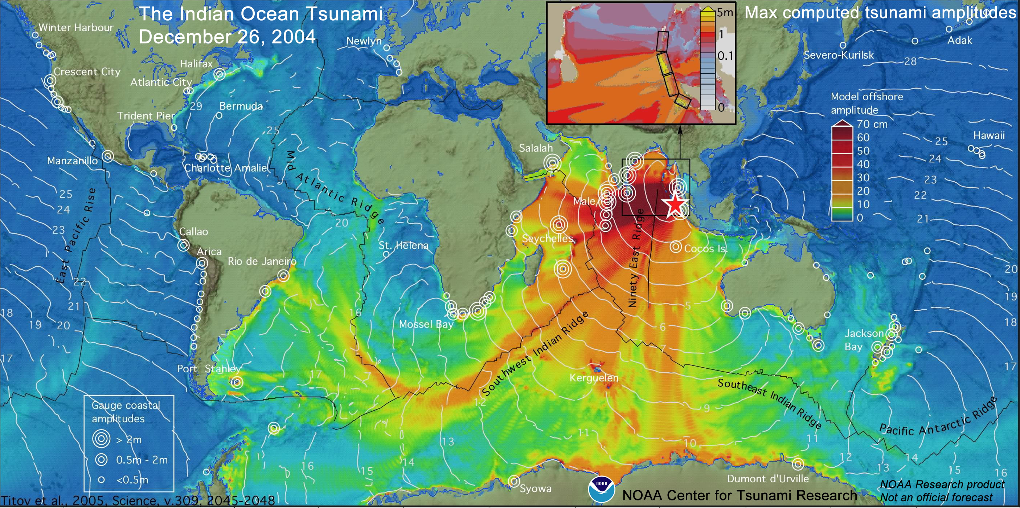
IOT input to NHRA webinar
Tsunami emergency risk management in Australia: maintaining the momentum
Jane Sexton, Matt Zanini and Yuelong Miao

Slide 2
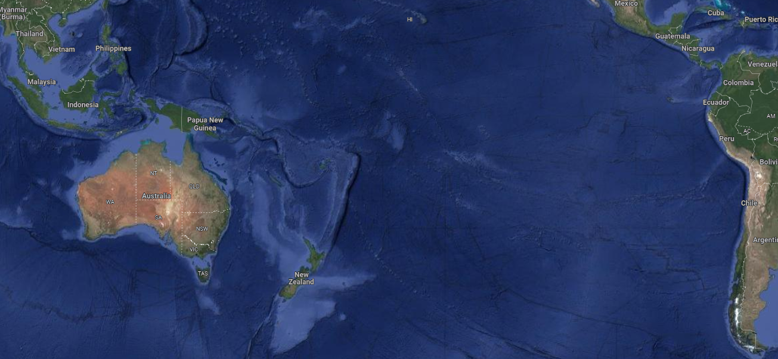
17 July 2006
M7.7
1 April 2007
M8.1
15 Jan 2022
Hunga Tonga-Hunga Ha’apai
27 Feb 2010
M8.8
10m run-up Steep Point

Slide 3
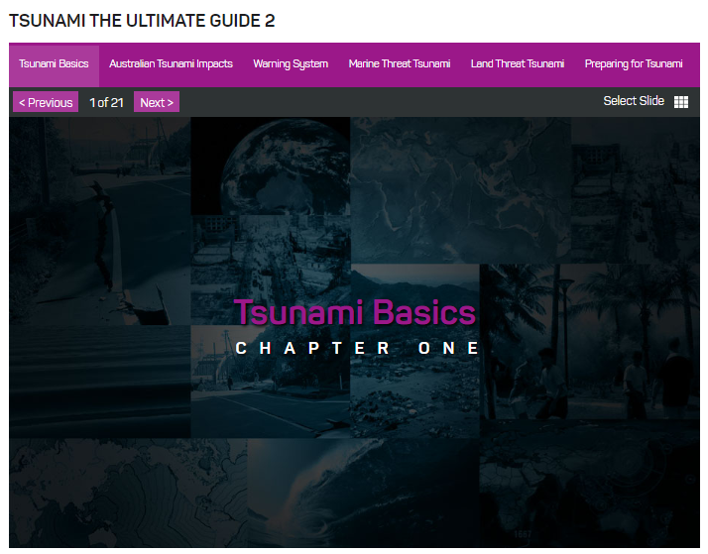
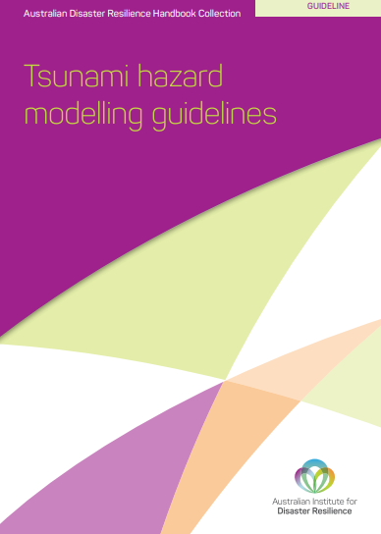
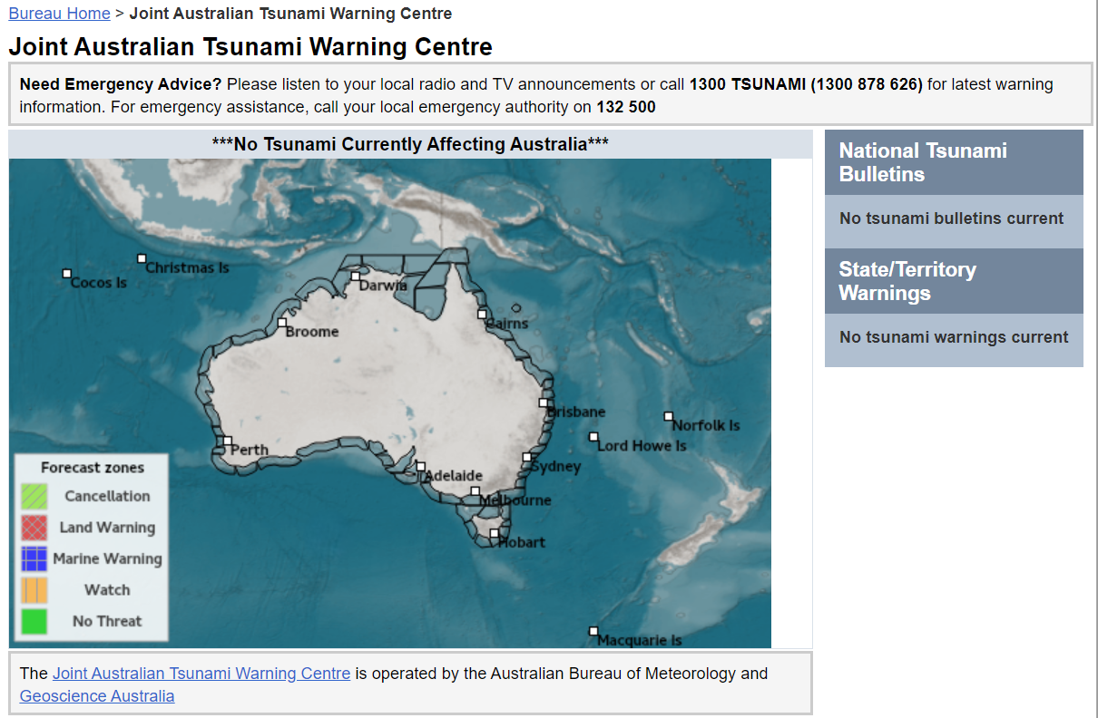
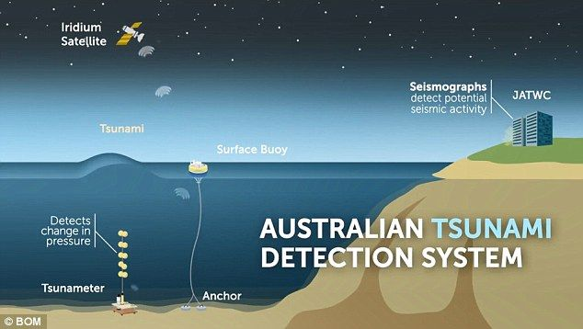
Where are we now:
Australian Tsunami Warning System
Australian Tsunami Advisory Group

Slide 4
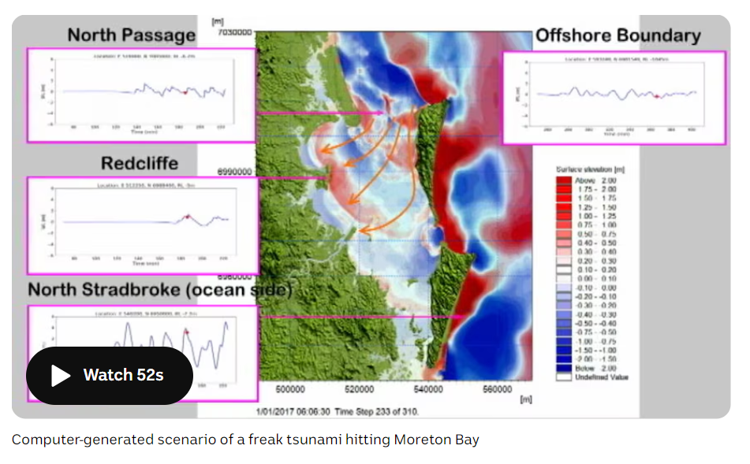
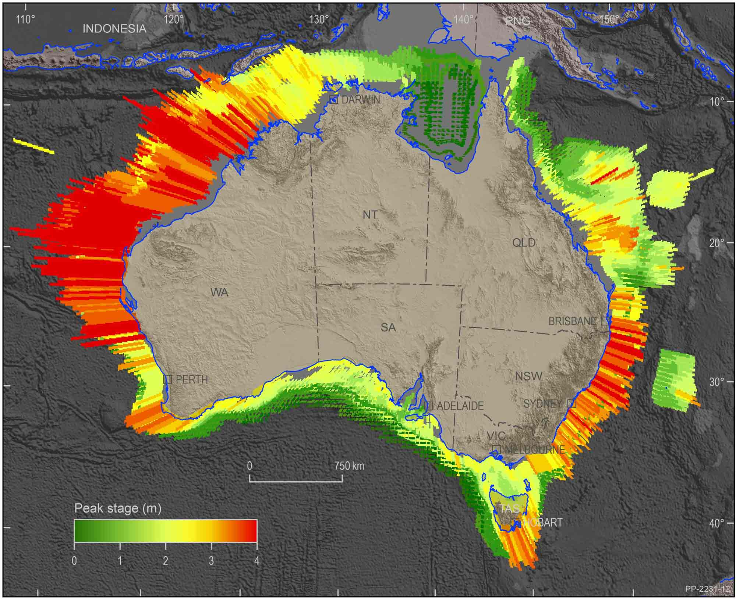
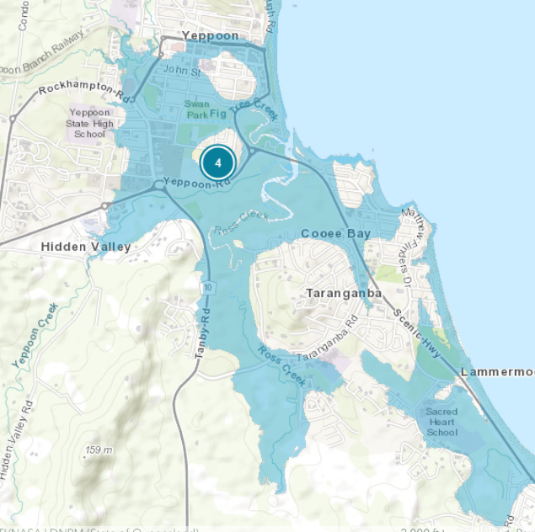
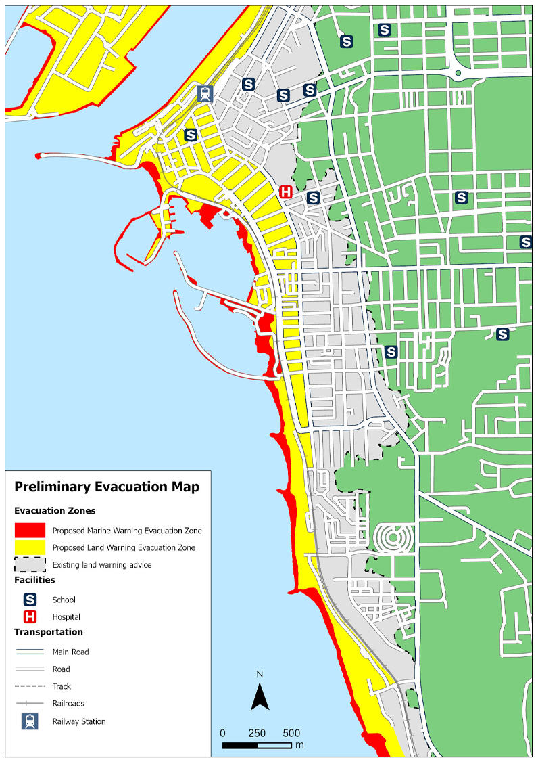
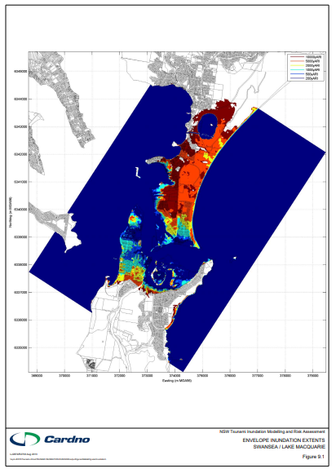
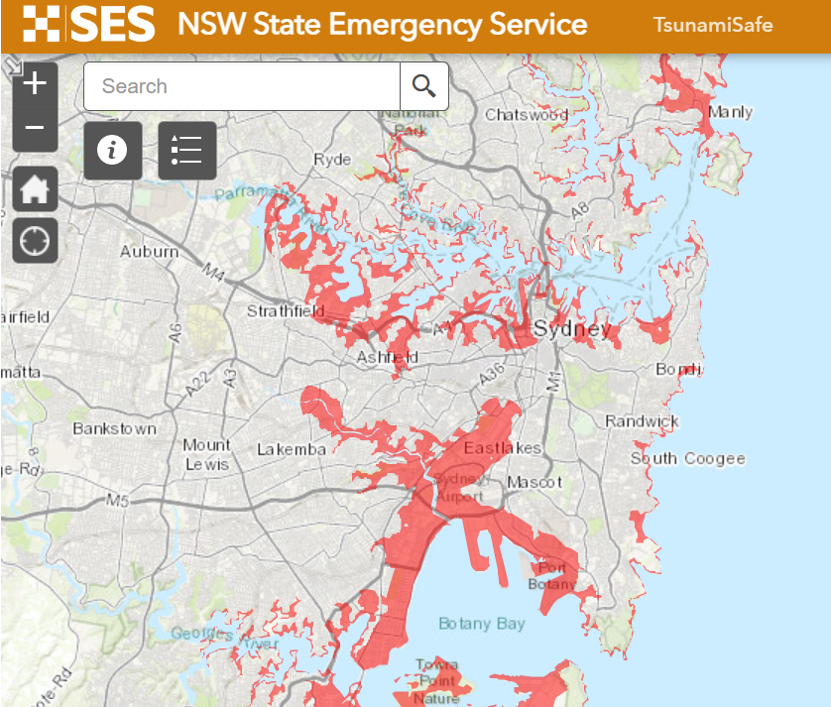
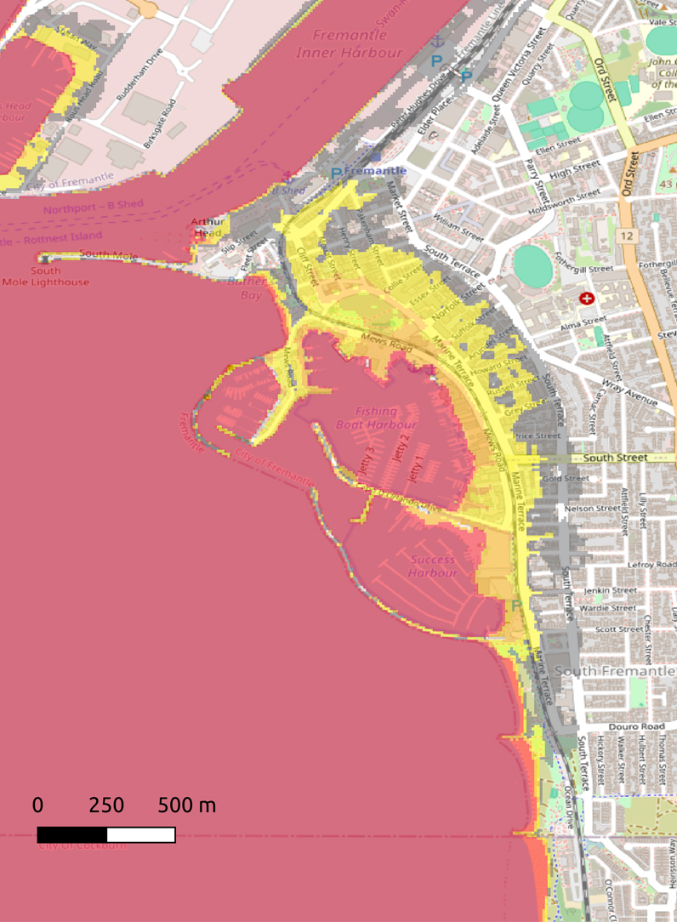
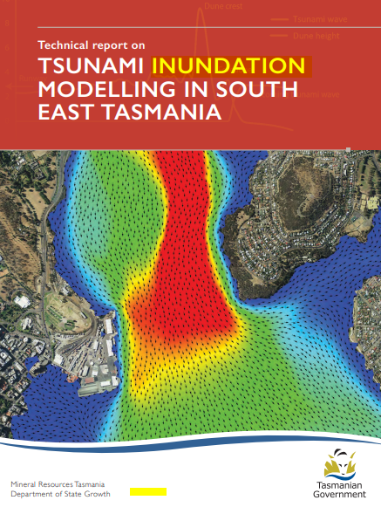
Where are we now:

Slide 5
Fast forward 20 years

Slide 6
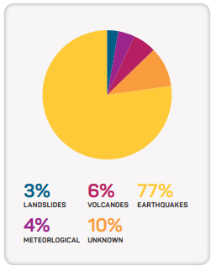
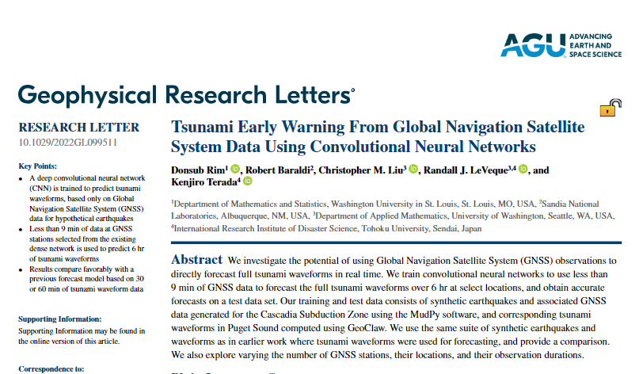
What research is needed:
Understanding risk
First Nations knowledge
Other tsunami sources; volcanic, submarine landslides
Ongoing inundation mapping
Opportunities
Including tsunami hazard in coastal adaptation planning and implementation
World Tsunami Awareness Day activities, drills
Collaboration
Managing risk
Ongoing improvements to the JATWC
Community awareness
Evacuation mapping
Exercising
Land-use planning

Slide 7
The future
Know our risk
Know what to do
Know our community
Read the article:
knowledge.aidr.org.au/resources/ajem-october-2024-tsunami-emergency-risk-management-in-australia-maintaining-the-momentum/

Slide 8
Questions:
hazard.risk@fire.qld.gov.au

