Slide 1
Managing across private and public land
WHAT are your agency challenges with managing fire risk in the public / private land interface?
Open discussion – common issues, management and solutions ?

Slide 2
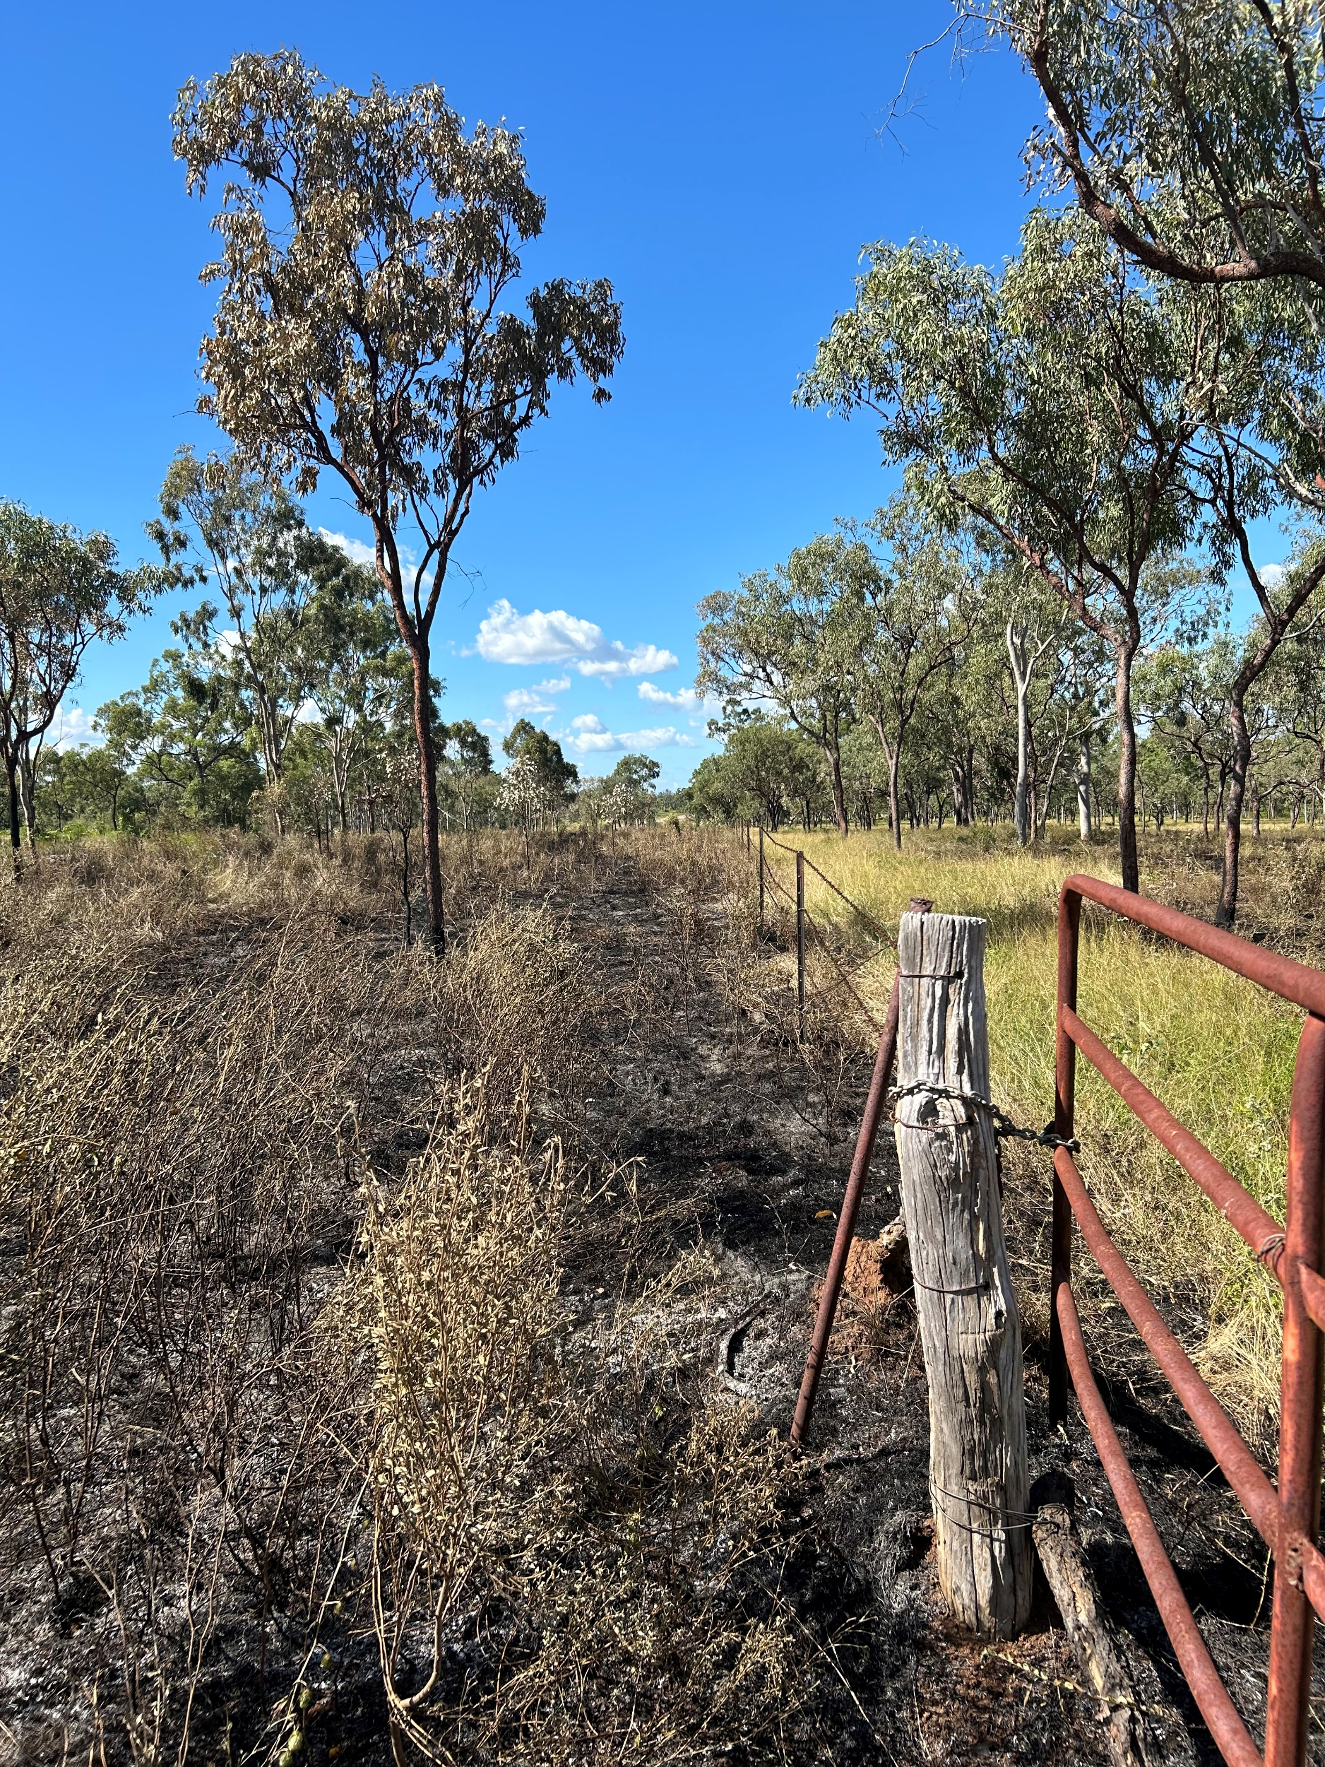
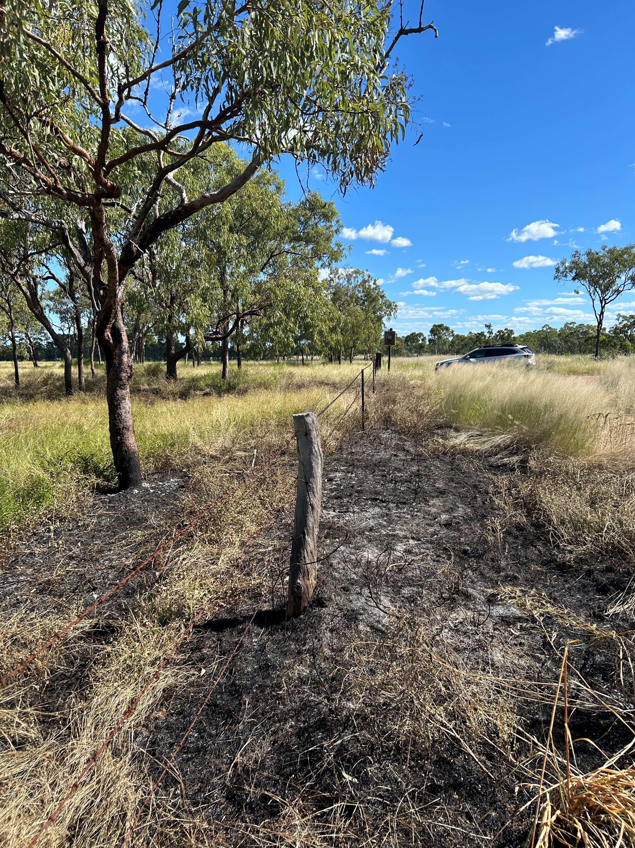

Slide 3
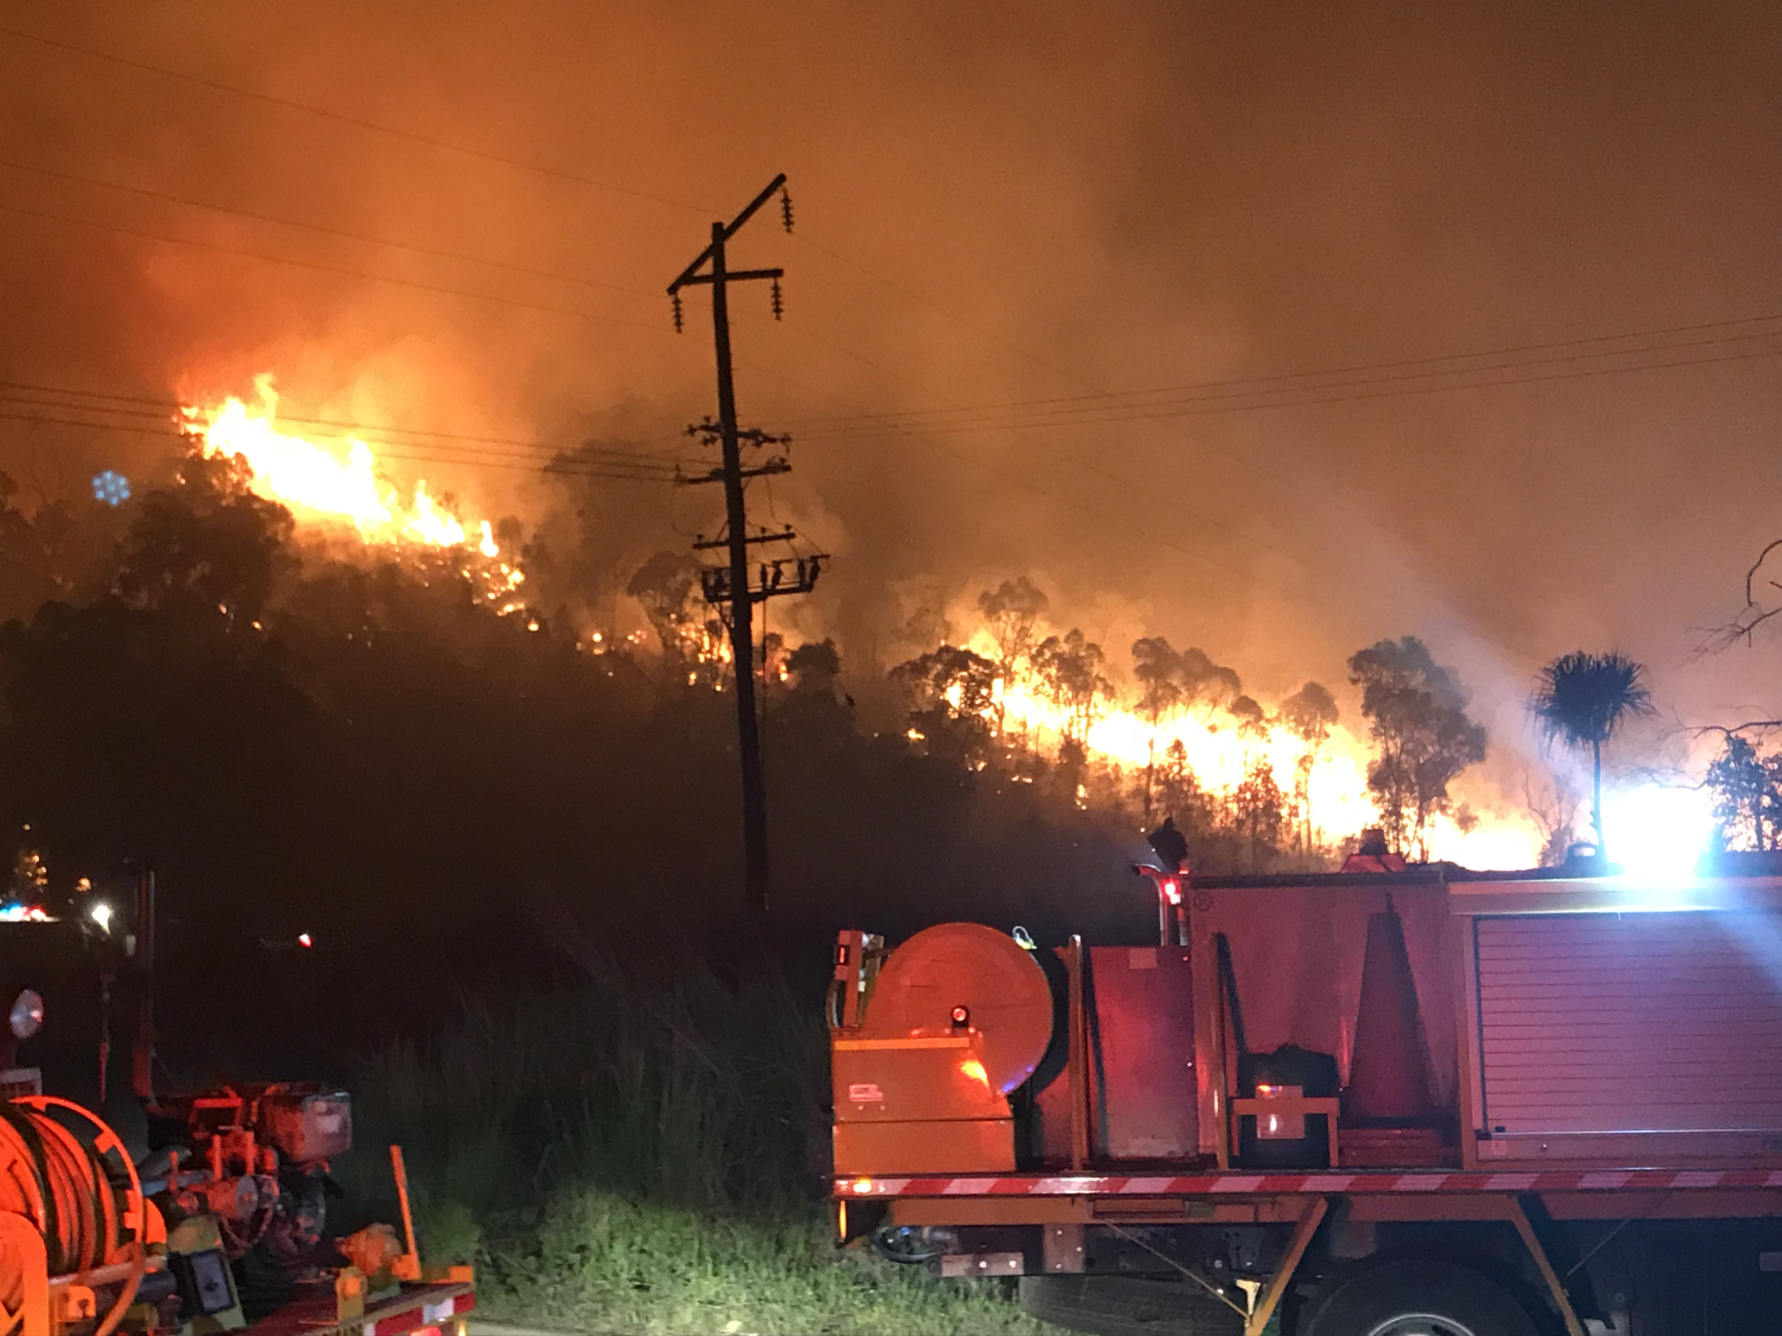
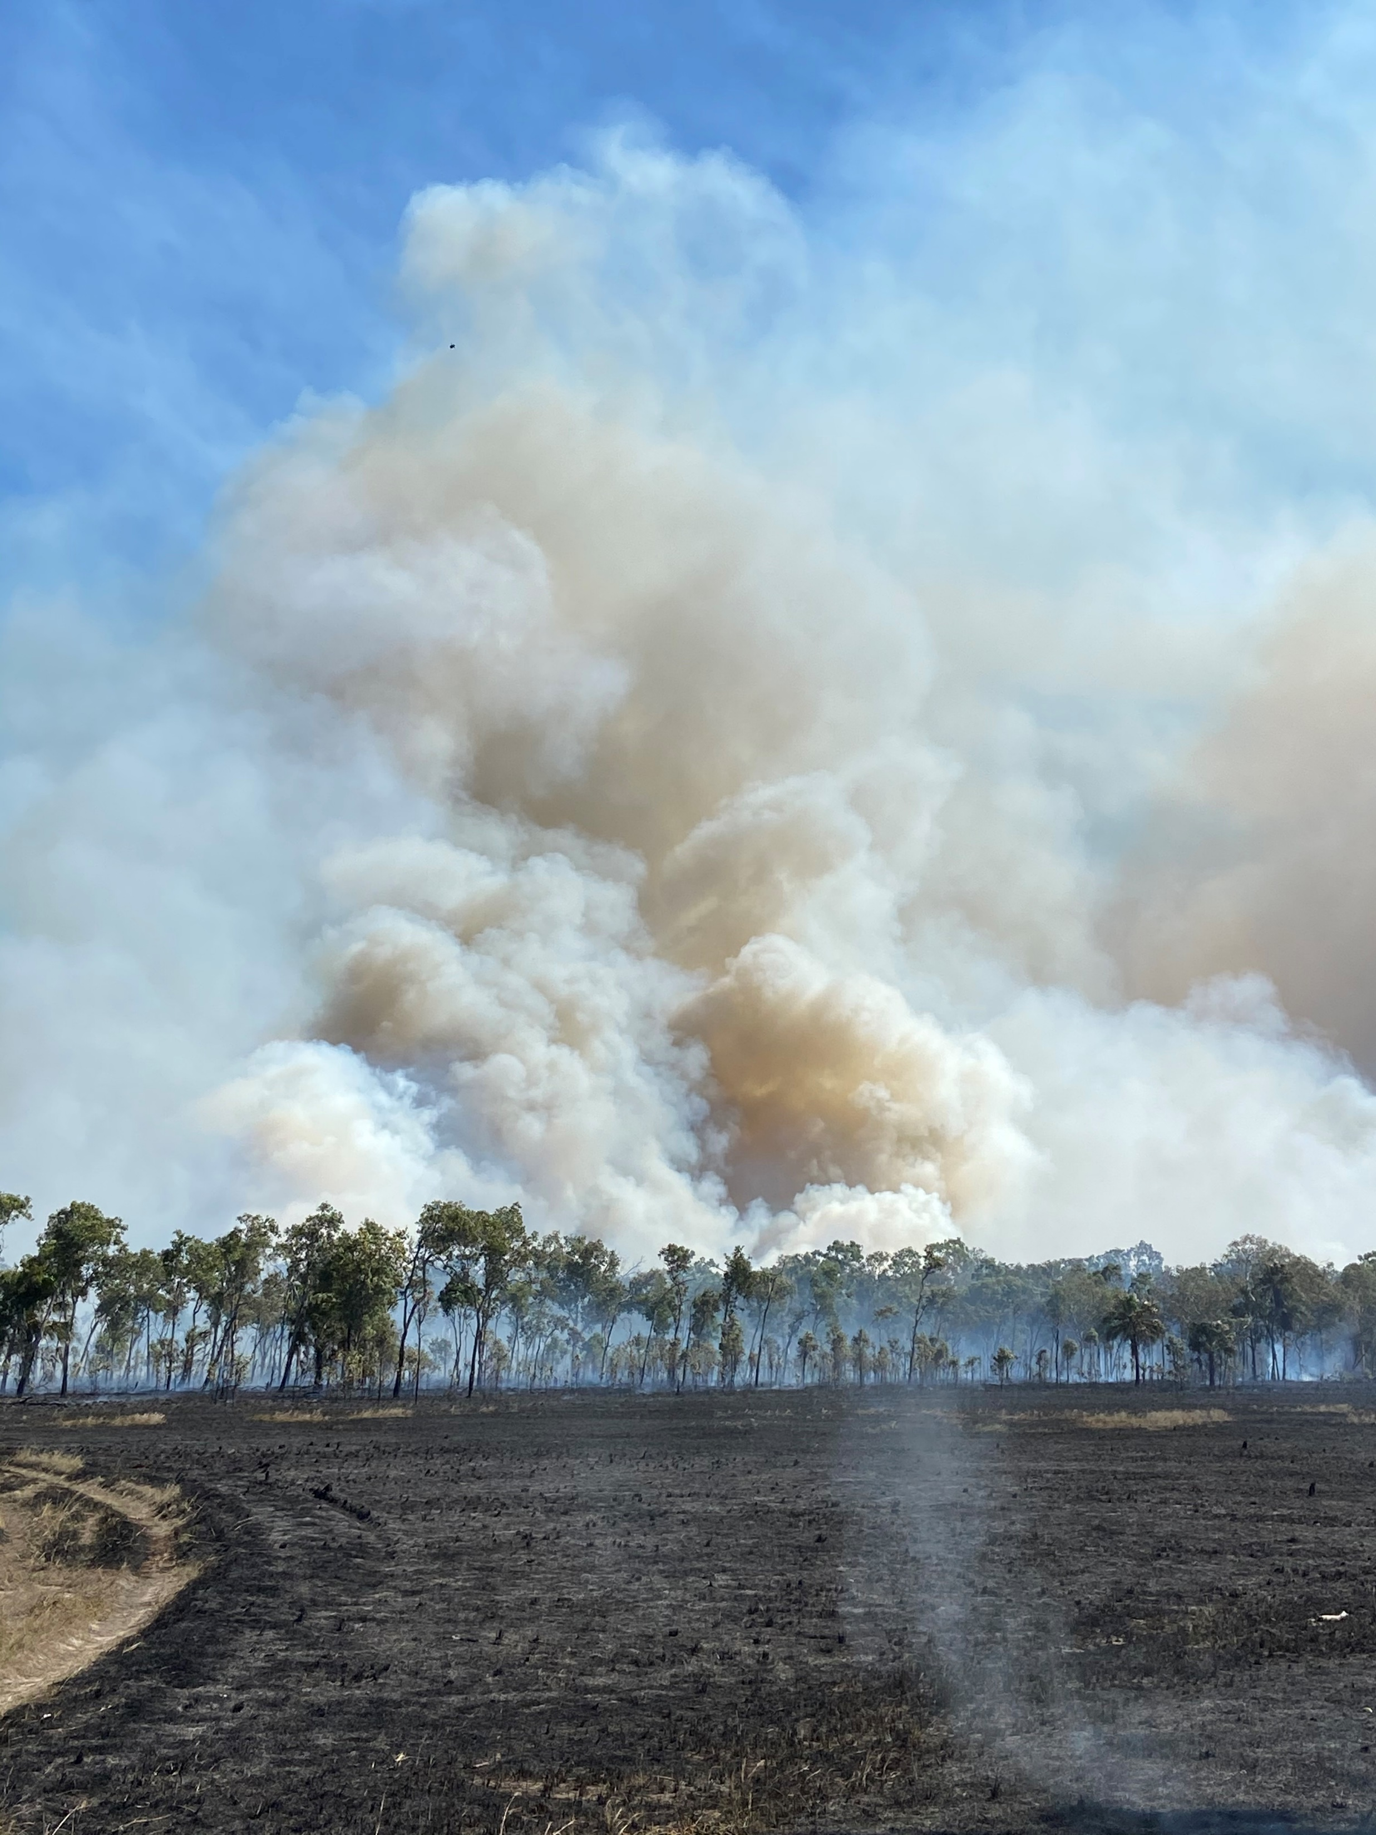

Slide 4
Questions to agency
What are the challenges for your
organisation / agency?
What do you do about it?

Slide 5
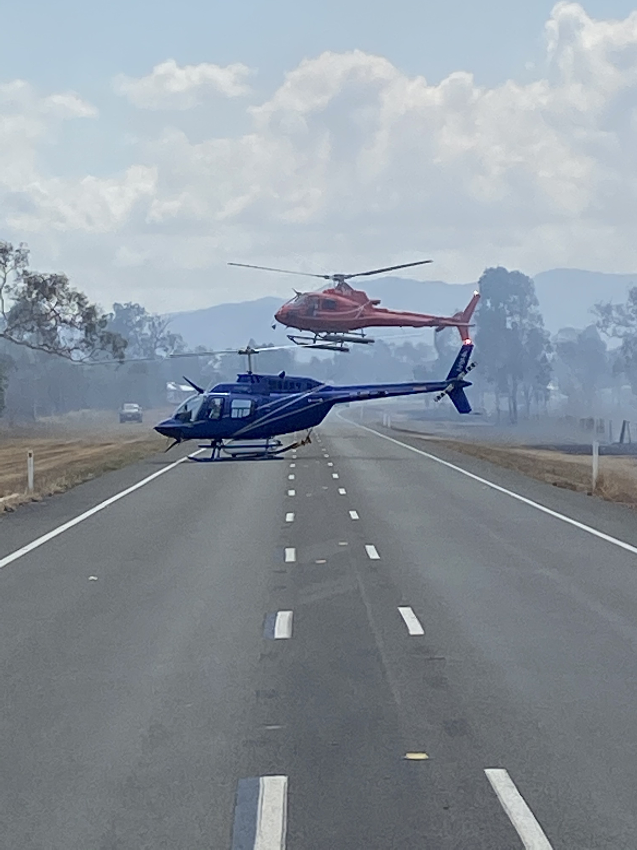
Open discussion at your tables
What are the challenges?
What can you do about it?
Is legislation the key ?
What are the public perception of our business?
What is the level of risk you are willing to carry ?

