Slide 1
HOW WAS FIRE PREDICTION USED? (and how can it be used in the future?)
Timothy Neale, Deakin University

Slide 2
This presentation summarises work from 3 projects
‘Established and emerging uses of Predictive Services’ NHRA 2021
‘Predictions in public’ NHRA 2022-ongoing
‘Pyrosecurity: understanding and managing bushfires in a changing climate’ ARC DECRA (2019-2022)

Slide 3
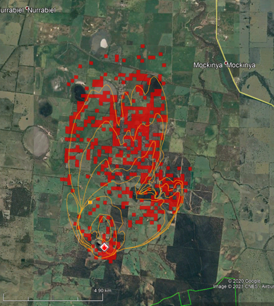
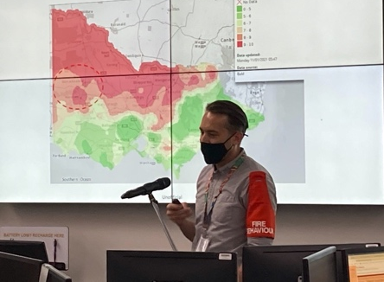
What is predictive services? Who are FBANs?
History:
1990s-2000s: real-time desktop models developed, alongside remote sensing
2010s: role implementation within incident control systems
2019-2020: all states (+ACT) have fire behaviour analysts in many control centres
me
Foresighting practitioners and capabilities within emergency management agencies…
OR: “Predictive services create intelligence products from data and information to support decision making. Predictive services can be used over a broad range of hazards to predict how a particular hazard might behave and what impact it may have… These predictions can be used to assess the potential impact of the incident from an analysis of the assets at risk and their vulnerability.” (AFAC Predictive Services Group, 2016)
SEE: Timothy Neale & Daniel May (2018) Bushfire simulators and analysis in Australia: insights into an emerging sociotechnical practice, Environmental Hazards, 17:3, 200-218.
Notes:
Long been forms of prediction in bushfire management
Growth of practitioners and tools specifically for making predictions – typically over the next 6-10 hours, but also over the next few days

Slide 4
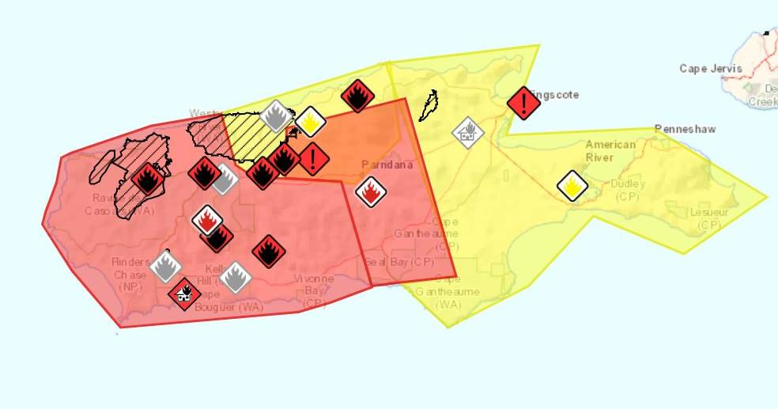
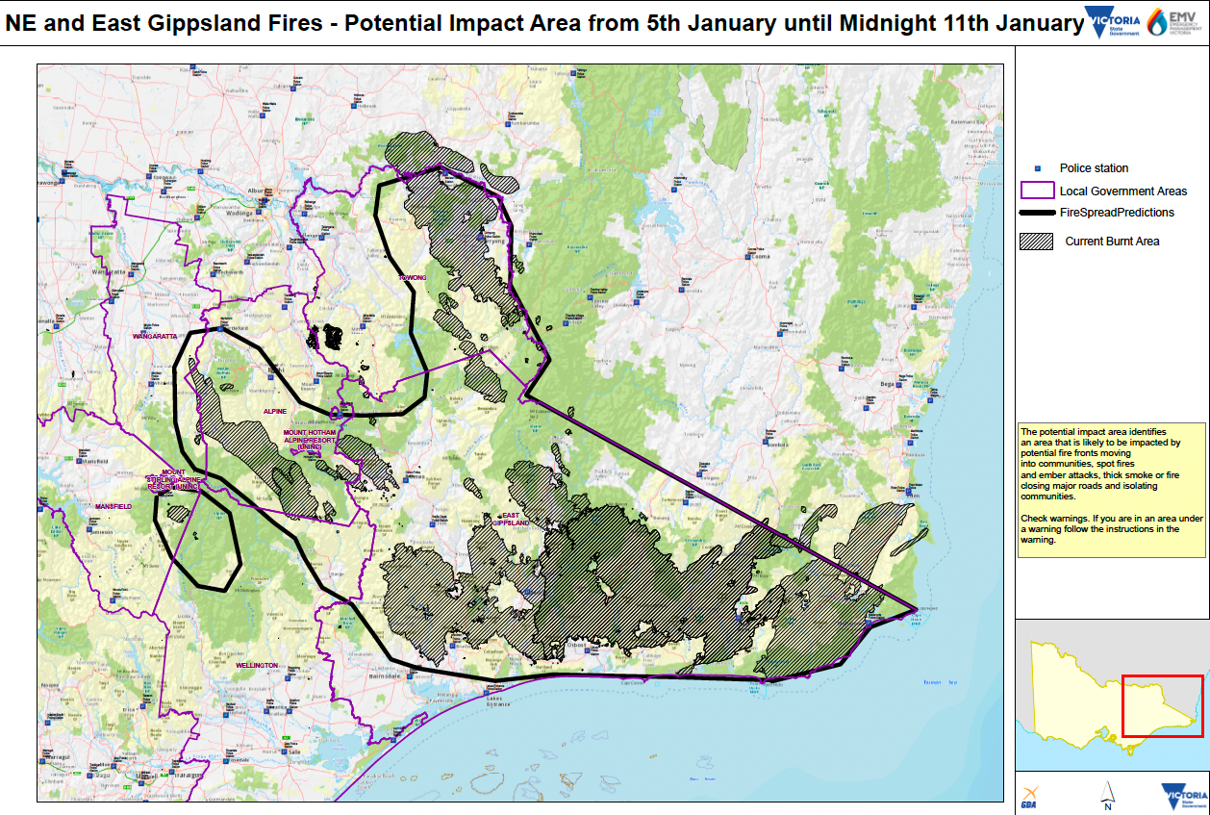
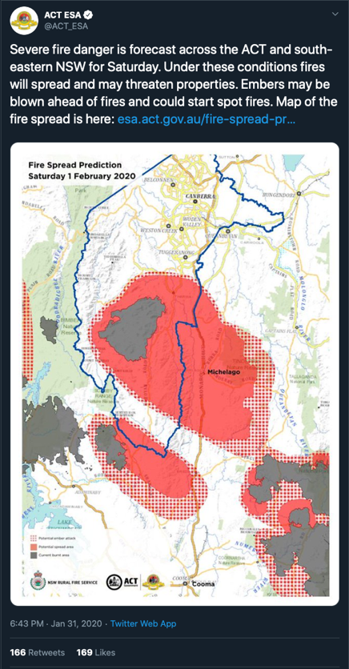
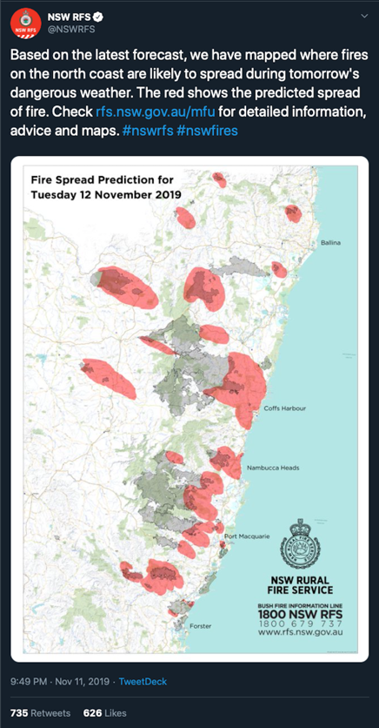
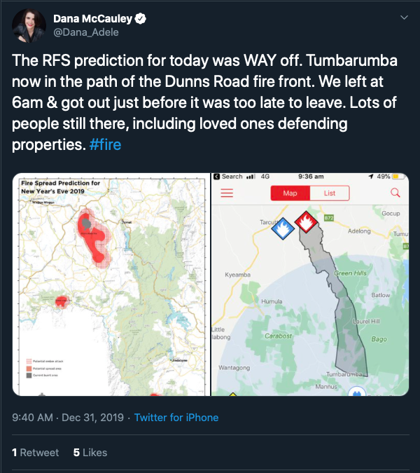
What happened in the 2019-2020 bushfire season?
Predictive services used widely in EM decision-making
e.g., often 4-5 on roster in state control centers (sometimes many more)
Predictive services used to generate new maps of potential fire spread for the public ahead of extreme conditions

Slide 5
Use of Predictive Services is growing nationally
Outputs are becoming available to publics
Then:
What is the likely future direction of Predictive Services? (We need social research…)
Notes:
Capability is expanding – in terms of tools and practitioners
Public interest and need is expanding
What’s the direction, and what do we need to get us there?

Slide 6
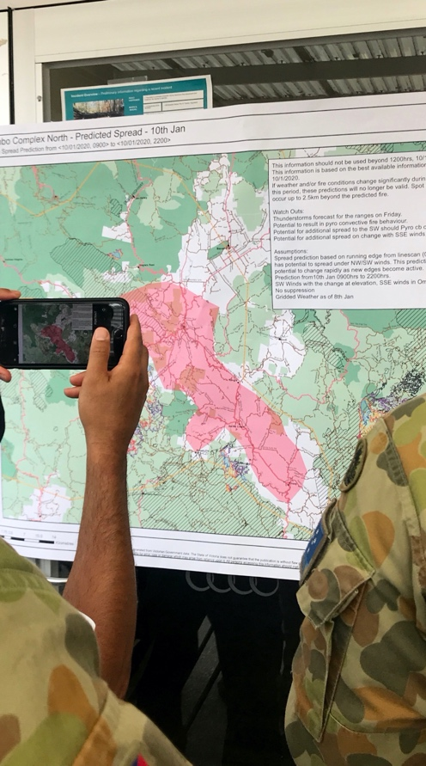
Two studies:
Headline: trust and usefulness come from experience, familiarity and education
National survey (200+) responses:
“A trusted FBAN…, is one who regularly meets users and visits firegrounds… it is therefore important that support is not simply devoted to tools and systems but, rather, fosters social connection between FBANs, their tools and their existing and emerging users.”
SEE: Neale T, Vergani M, Begg C, et al. (2021) ‘Any prediction is better than none’? A study of the perceptions of fire behaviour analysis users in Australia. International Journal of Wildland Fire. DOI: https://doi.org/10.1071/WF21100.
Interviewed SMEs (25) from Vic agencies:
Trust in predictive outputs: high level of trust in outputs, variances in the level of trust in FBANs
Timeliness of predictive outputs: advice and outputs are produced in a timely manner
Benefits of releasing outputs publicly: general support, with appropriate guidance and instructions
Risks of releasing outputs publicly: political and legal risks to agencies and staff, potential safety risks from misinterpretation
SEE: Begg, Chloe, Graham Dwyer, Timothy Neale, and Ian Pollock. 2021. Established and emerging uses of predictive services in Victoria. Bushfire and Natural Hazards CRC (Melbourne).

Slide 7
Recommendations
Recommendation 1: that agencies explore which outputs could be released publicly to support planning and decision-making
Recommendation 2: that agencies explore how outputs can be utilised to better support other relevant functions such as planned burning and public information
Recommendation 3: that agencies explore the ongoing training and development needs of FBANs
Recommendation 4: that agencies work with FBANs to develop continuous learning processes which can be used to improve predictive services

Slide 8
What happens now? We talk to more stakeholders, test maps, design maps…

Slide 9
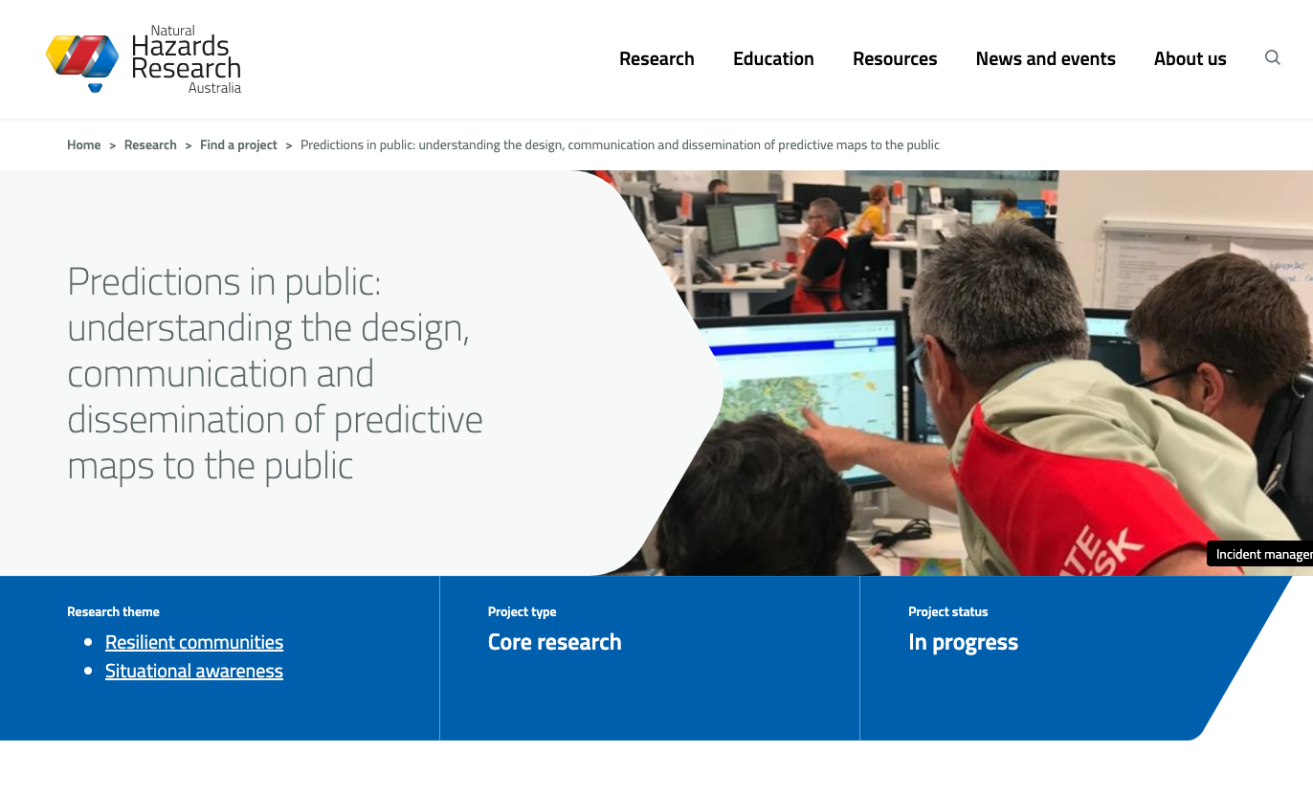
Team: Chloe Begg, Paula Dootson , Erica Kuligowski , Amy Griffin , Timothy Neale, Graham Dwyer, Angela Gardner, Gabrielle Miller
Phase 1: SMEs and literature review = public predictions would be best reserved for impactful fires during extreme or catastrophic fire weather conditions and should be produced and designed as a specific product distinct from those used by agencies
Phase 2: Developing and testing national predictive map concepts to be communicated and disseminated across Australia
Phase 3: Development of fit-for-purpose outputs that can be directly translated into policy and practice

Slide 10
Thanks to
Chloe Begg, Gab Miller, Paula Dootson , Erica Kuligowski , Amy Griffin , Graham Dwyer, Angela Gardner
AFAC Predictive Services Group and AFAC Warnings Group
NHRA, BNHCRC, ARC
Find out more about this work at naturalhazards.com.au and timneale.me

