Slide 1
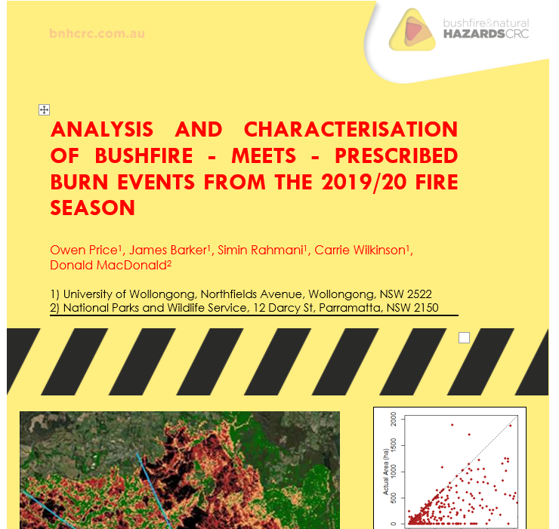
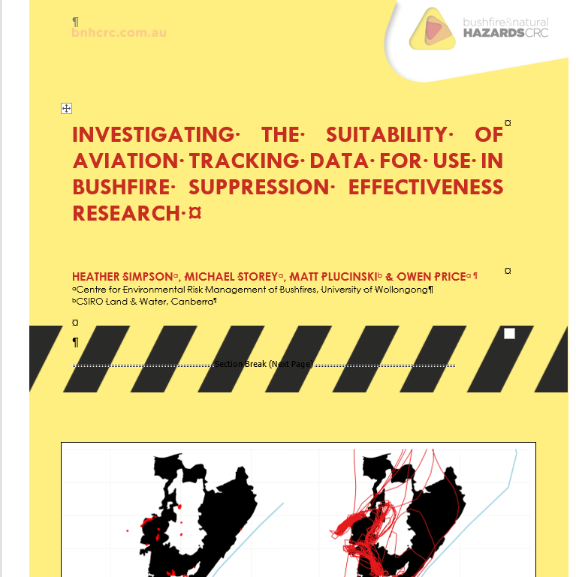
Black Summer Bushfire Research
By the Centre for Environmental Risk Management of Bushfire

Slide 2
A) Bushfire – Meets – Prescribed fire events
Design an operational Fire-meets-Fire Database
Examine how prescribed burns influences the severity of the 2019/20 bushfires
Reconstruct how the bushfires interacted with prescribed burns

Slide 3
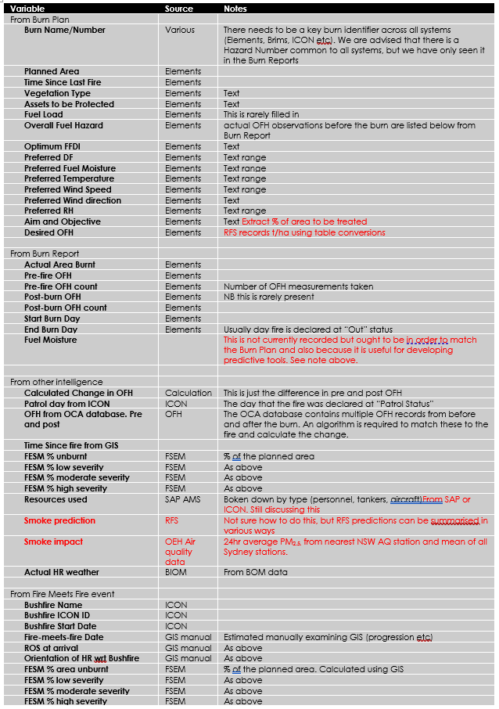
A bushfire-meets-prescribed fire database
The only way to truly evaluate prescribed burning is by analysing what happens when a bushfire encounters it.
To do this properly you need information about
The Prescribed burn
  Burn objectives
  Burn conditions
  Fuel Reduction Achieved
  Fire Severity (map)
The subsequent Bushfire
  Time Since the Prescribed Burn
  The outcome of the interaction
  Severity in the Prescribed Burn
  Operational Advantage
This information requires improvement to data collection and integration of existing databases

Slide 4
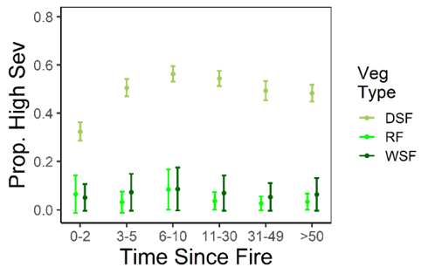
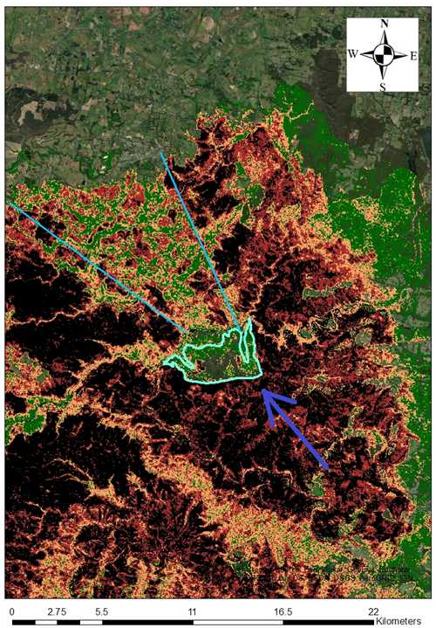
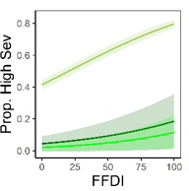
Analysis of effect on bushfire severity
60,000 points across all 2019-20 bushfires in NSW
Model = High Severity vs Time Since Fire + Forest Type + Climate + Topography + Weather on the day
Results
Prob of High severity lower in TSF <=5 years
But only for Dry forest
Severity lower in
  High slope
  Low FFDI
  High Live Fuel Moisture

Slide 5
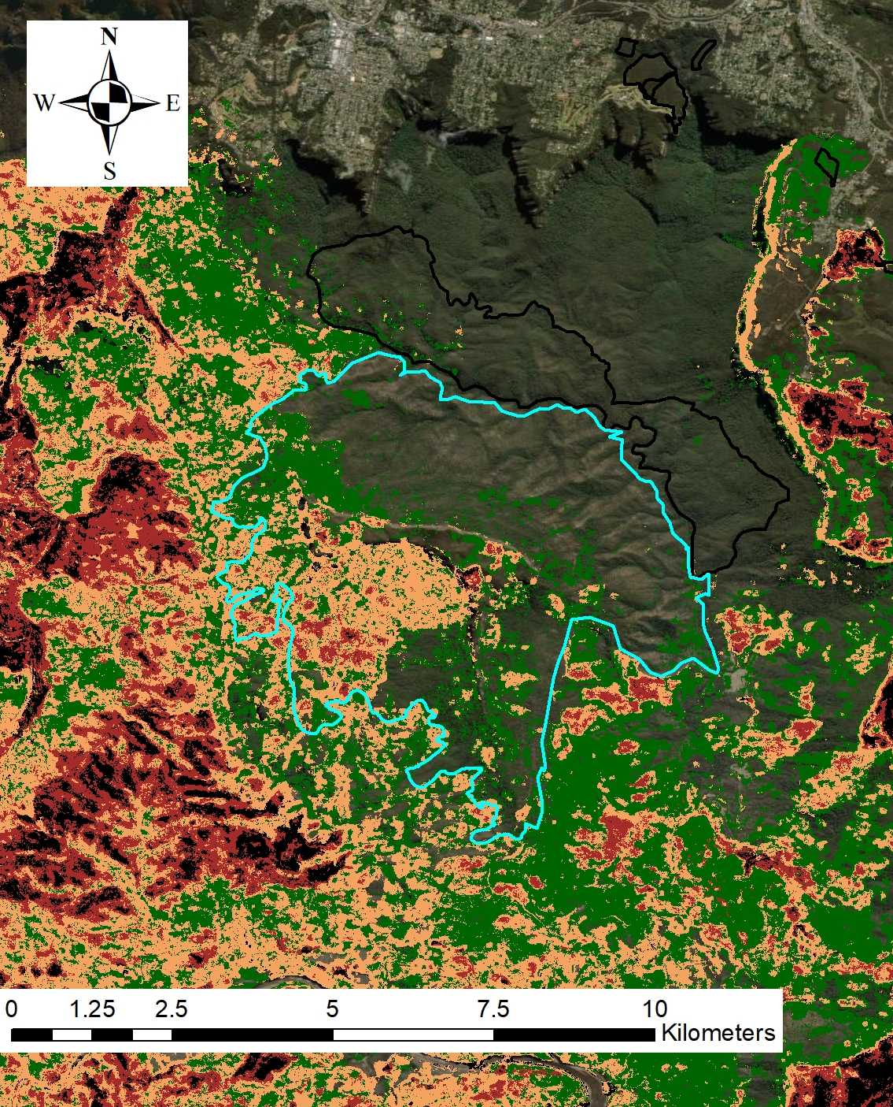
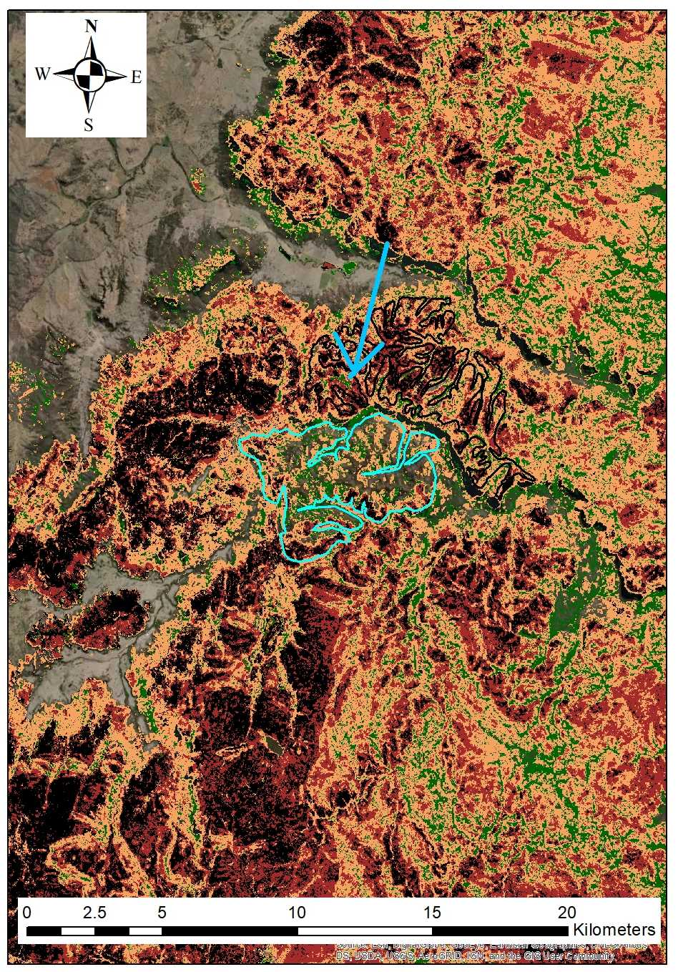
Reconstructing fire interactions
509 cases examined
A) Mt Solitary Ck May 2018, stopped Green Wattle fire 2019
B) Brooks Plateau SFAZ 2019 left a shadow in the Currowan Fire
c) Rocky Creek 2018 gave advantage in Gospers Mtn fire

Slide 6
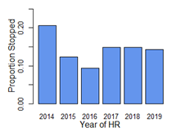
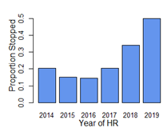
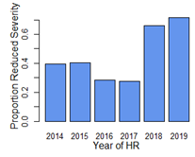
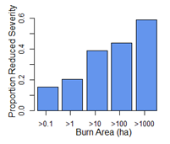
Results – interactions
What proportion of interactions had effects?
Stopped at Boundary
Stopped within patch
Reduced Bushfire
Severity
Bushfires rarely stopped on meeting an HR
But most recent HRs stopped bushfire within patch
Most recent HRs reduced the severity of bushfire
Rapid drop off with HR age
And rapid increase in effect with HR size
Severity effect vs
HR age

Slide 7
What next?
There are several initiatives on developing fire databases
Evaluation needs periodic revisiting of this kind of analysis

Slide 8
B) Aviation tracking data
Part 1 – Explore the drop data
Part 2 – Investigate drop objectives
Part 3 – Case studies of effectiveness

Slide 9
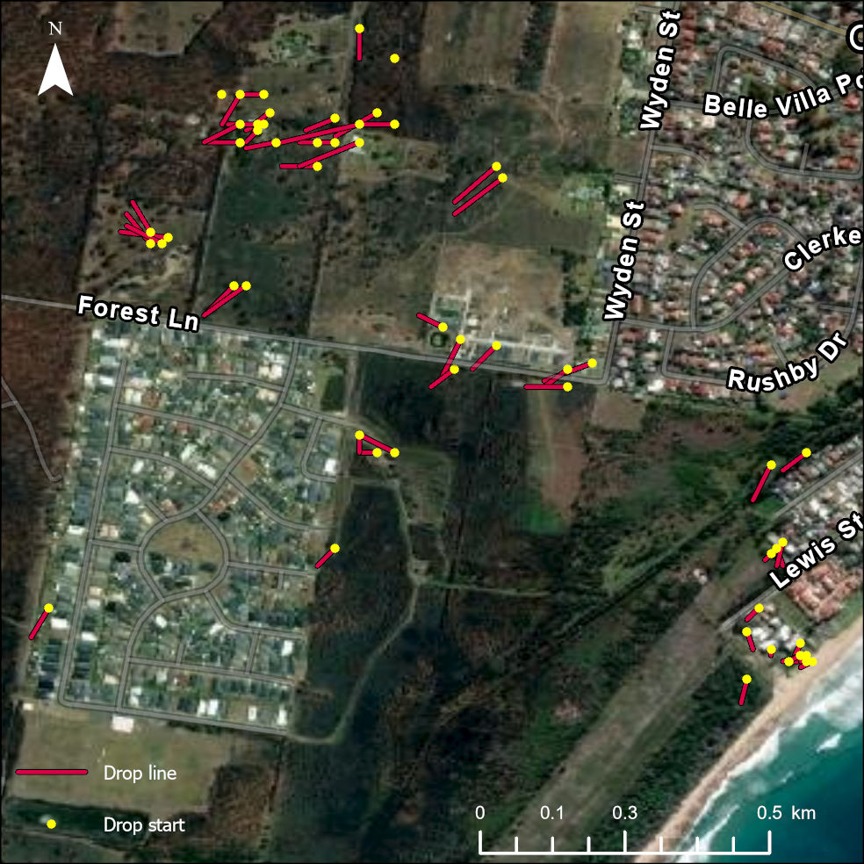
The data
70,000 drop locations from NSW in 2019/20
There are some issues:
50% of aircraft missing (including VLATs)
Drops over water
Drop lines > 1 km long
Can match them to data on:
Fire progression (linescans)
House locations and impact
Weather
Interviews with 10 Air Attack Supervisors
Operational logs etc

Slide 10
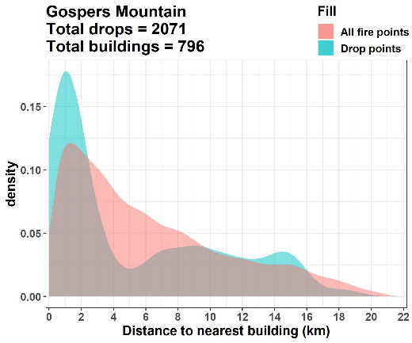
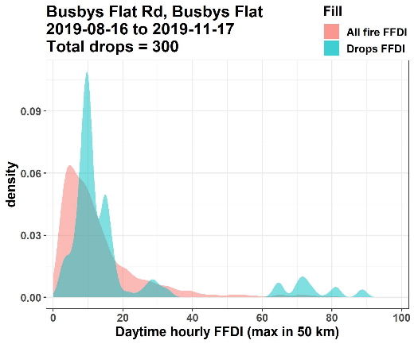
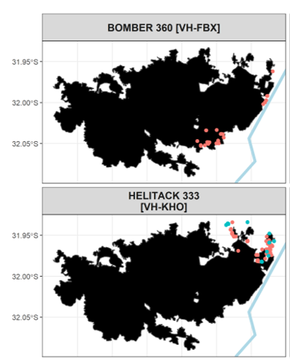
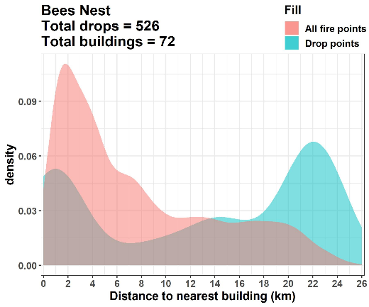
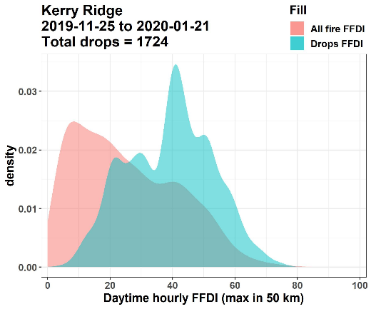
How are aircraft used?
1) Houses: near v far
2) FFDI: Low v High
3) Comparing aircraft

Slide 11
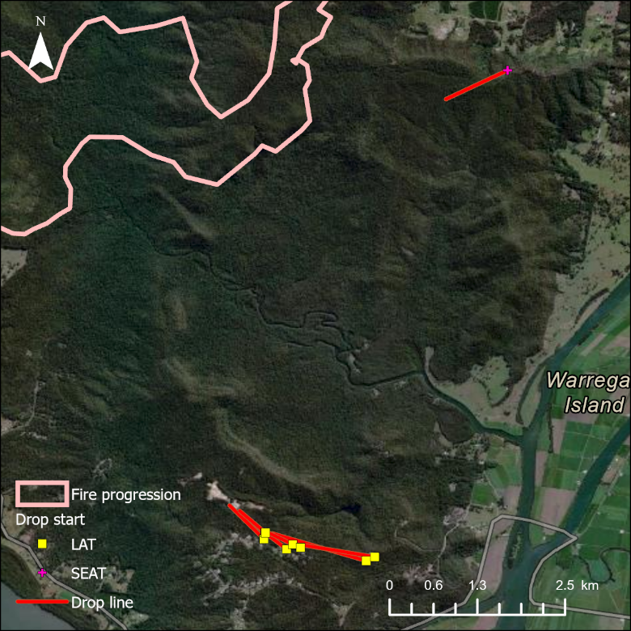
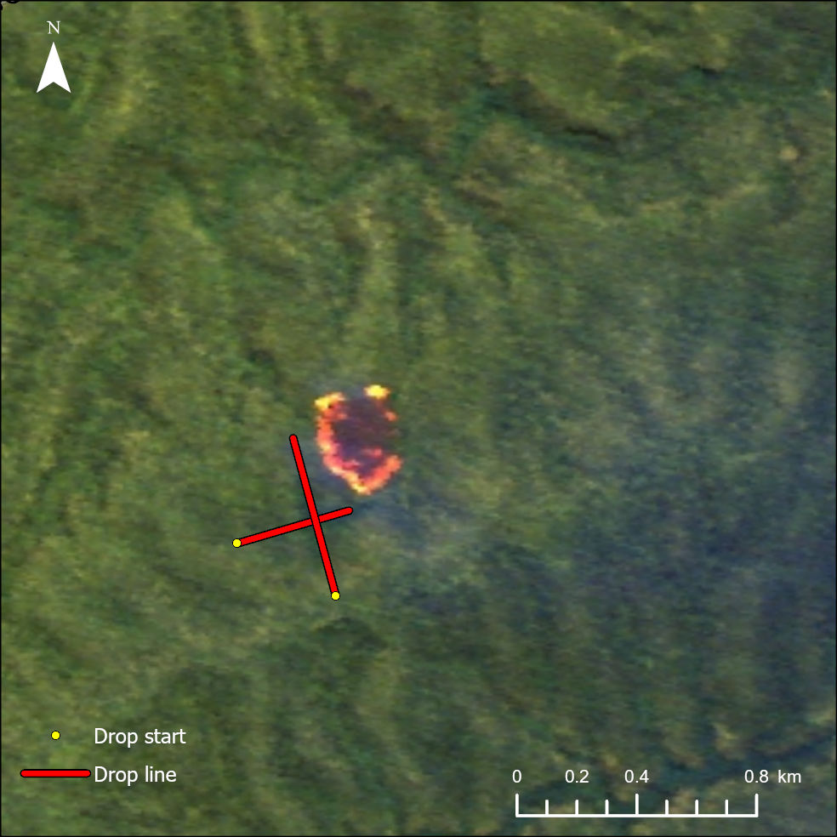
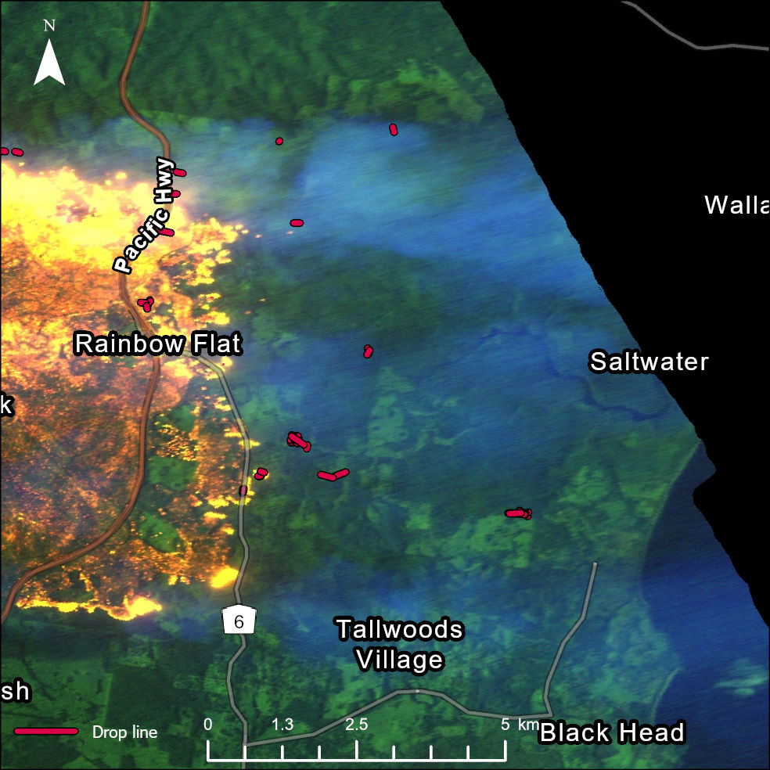
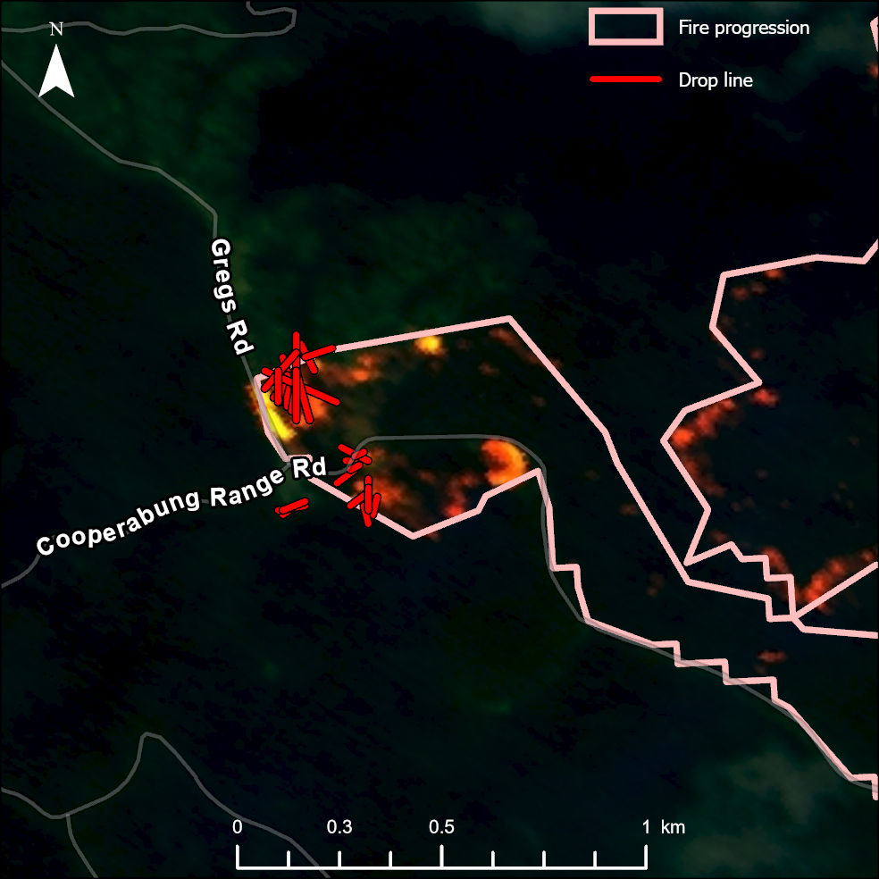
Property Protection
Example objectives
Initial Attack
Spot suppression
Direct Attack
Some of this could be automated

Slide 12
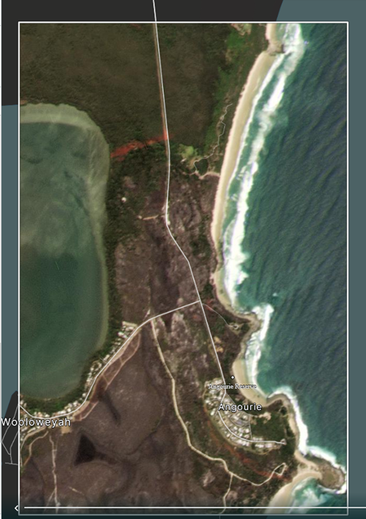
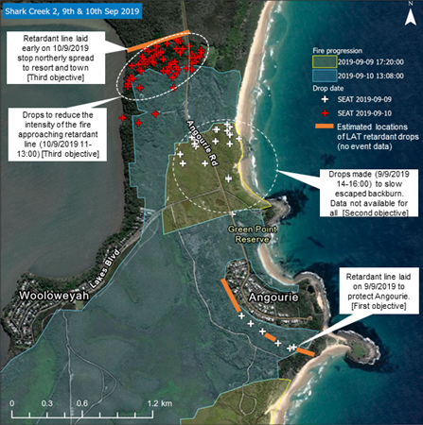
Case study: Angourie Fire (Sept 2019)

Slide 13
Next Steps
We hve demonstrated how useful air tracking data can be
There is an opportunity to analyse vast amounts of it, focussing on:
  Profiling how aircraft are used
  Automatically determined objectives
  Effectiveness v effort + weather + aircraft type
  States where data is more complete

