Slide 1



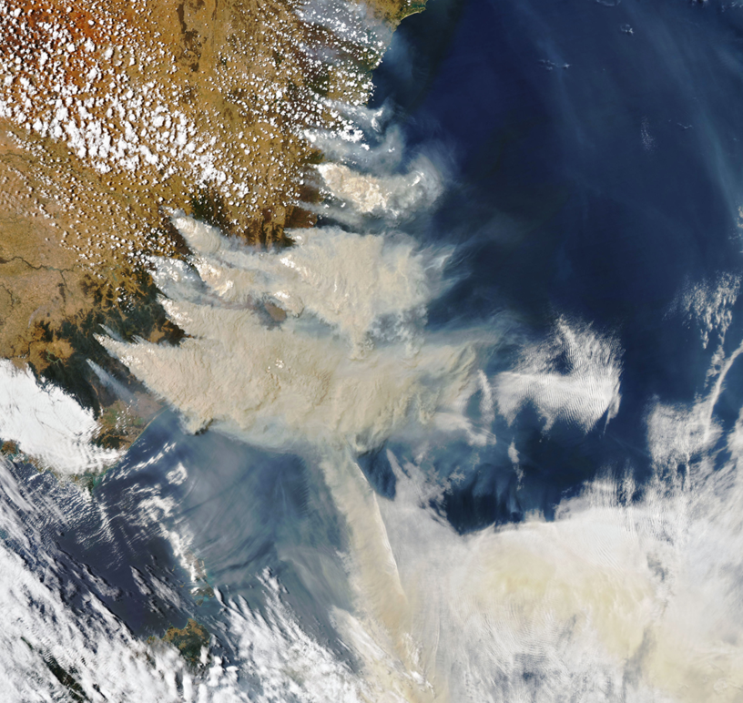
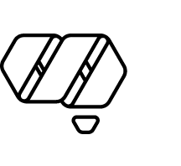
ACCESS-Fire simulations
Black Summer Case Studies
Dr Mika Peace
High Impact Weather Research
Bureau of Meteorology and Natural Hazards Research Australia
NASA MODIS Aqua Satellite
4 January 2020
© Natural Hazards Research Australia 2023
Notes:
DESIGN INSTRUCTIONS:
Add text to editable text boxes.
Avoid moving or changing the margins for text boxes, to ensure a well-presented slide.
To add a colour to the cut-out shape/background:
To fill cut-out shape/background with colour, right click next to the slide and select ‘Format Background…’ from the drop-down menu.
In the side panel that pops up, select ‘Solid fill’ and then choose one of the ‘Theme colours’ at the top of the colour chart.
Note: the ‘Theme colours’ are NHRA corporate colours and should be used wherever possible.
To add an image to the cut-out shape/background:
click on the image icon to select an image source
once you’ve added an image, right click the image and select ‘Send to Back’ so that it sits behind the cut-out shape

Slide 2

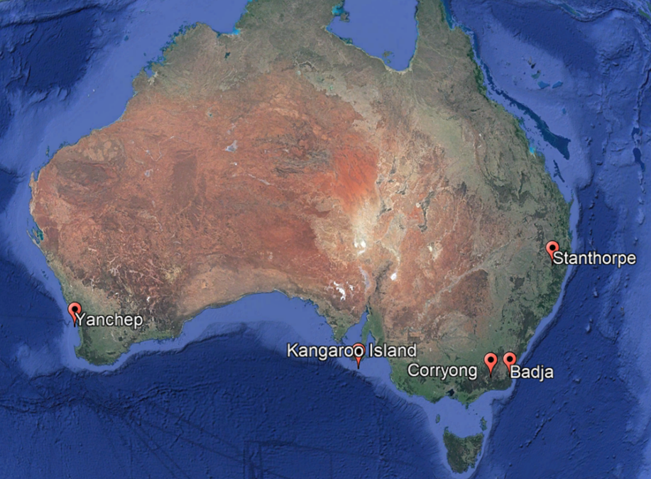
Fire-atmosphere interactions
Case study motivation:
Fires that were particularly challenging for response agencies and/or where extreme fire behaviour occurred.
Fire-atmosphere interactions:
Low Level Jets (elevated winds descending to the surface adjacent to plume)
Fire Generated Vortices (fire whirls with tornado strength winds)
PyroCb (fire generated thunderstorms)

Slide 3
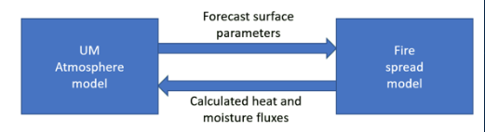
Coupled Fire-Atmosphere model
ACCESS-Fire
Fire spread model(s) coupled to the ACCESS Numerical Weather Prediction model
Nested domains used to 300m resolution. Fire runs on innermost nest
Fire initialized from point ignitions or observed fire perimeter
Simulations use DEFFM for eucalypt forest and grass fire spread models
Most runs use simple fuel inputs - constant fuels with fuel loads 20-30 t/Ha

Slide 4
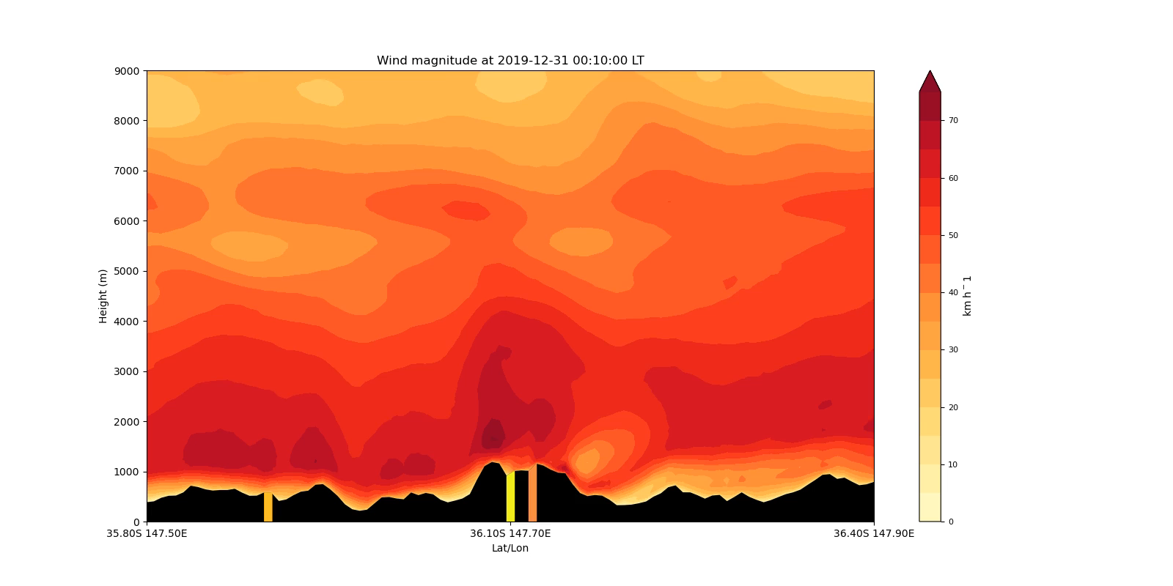
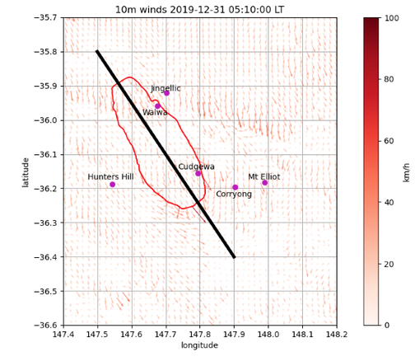
Corryong simulations with
ACCESS-Fire
Vertical cross-section of wind speed (m/s).
10 minute time intervals. Orange/ pink on black topography shows fireline
Wind maximum at 1000-2000 m elevation. 80+km/h (red shading)
Extreme winds adjacent fire front (consistent with damage observations)

Slide 5
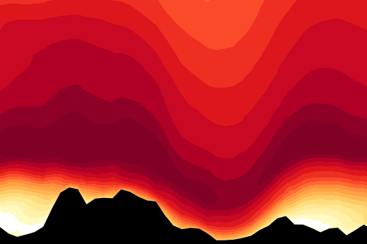
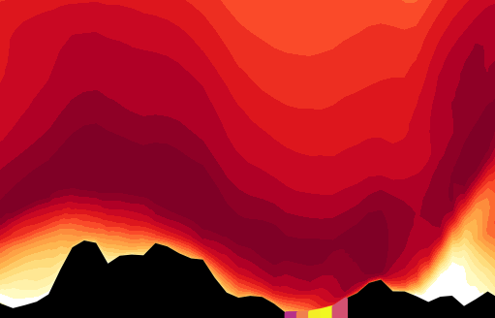

Corryong simulations with
ACCESS-Fire
Fire-atmosphere coupling 'OFF'
Fire-atmosphere coupling 'ON'
Vertical scale = surface to ~4000m
0410 LT 31 December 2019

Slide 6
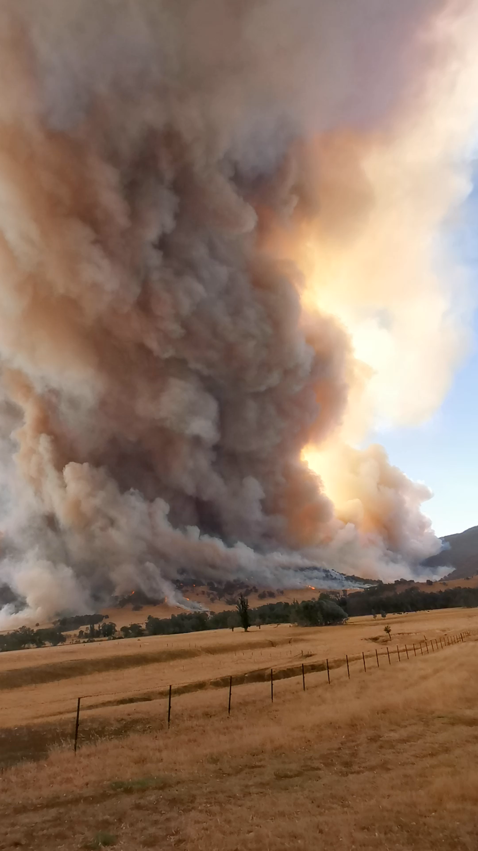
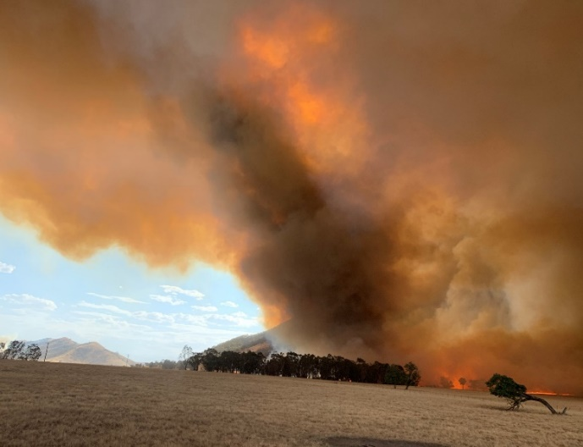
Green Valley
Fire Generated Tornadic Vortex
Rotating convection column at 0630 UTC
FGTV emerging from the head fire & moving downstream.
A ‘shedding’ or ‘wake’ vortex
Photo courtesy Mr Scott Anderson
Video courtesy Mr Ashley Drummond

Slide 7
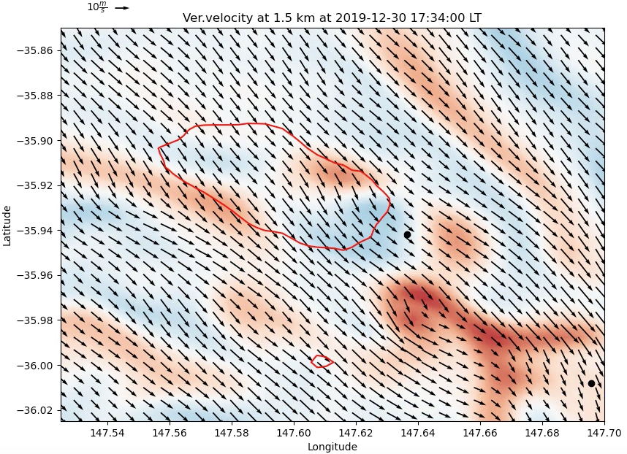
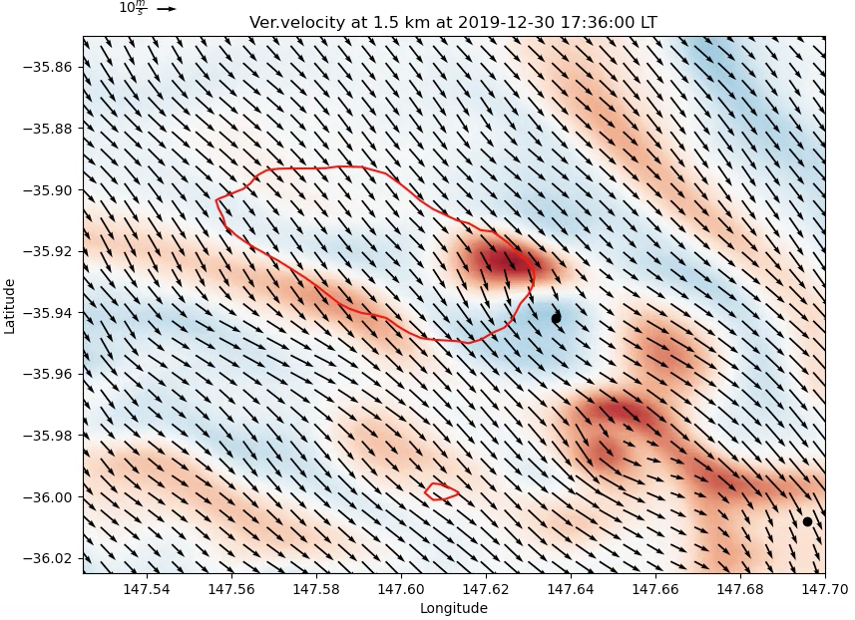
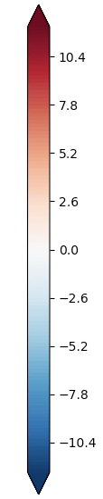
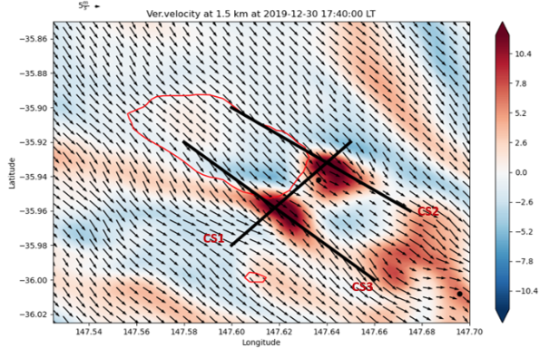
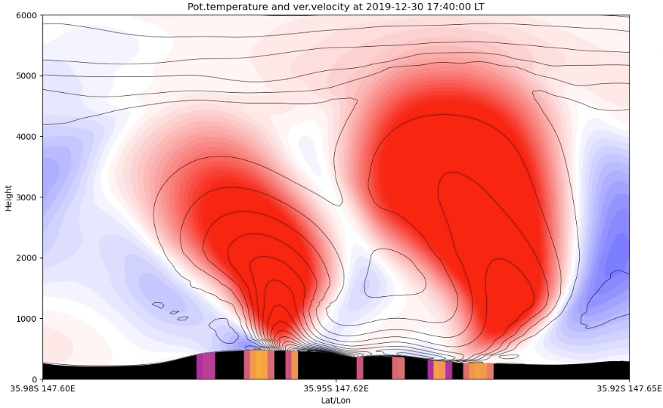
30 Dec 2019
Vertical velocity (m/s, blue = down, red = up)
Wind (arrows) at 1.5km elevation
Time series at 2-minute intervals
Transient pulse of upmotion – short lived
Simulated 'stretch' location matched the FGV
Vortex formation needs (1) spin and (2) stretch components
0636 UTC
0638 UTC
B
A
A
B
1.5 km elevation
0640 UTC
Notes:
Vortex development –
Stretching component
Spin component.

Slide 8
Summary:
ACCESS-Fire simulations capture processes - FGVs, LLJs, pyroCb
Simulations consistent with observations
Difficult to get data from inside large fires – simulations can develop understanding
Future major fire events are inevitable
Uncoupled (surface based) predictions/simulators underpredict fire behaviour at large destructive fires
How do we develop the best science and ensure its applied in context for optimal decision making?
NHRA T1-A1 project – 3 learning modules - training and upskilling FBAns and FireMets
NHRA T3-A4 project – Fire Case Studies – streamlined case study process for impactful weather events
ACCESS-Fire model development and testing
Fundamental research (FGV's, ember transport, pyroCb, fire modified winds, LLJs)
Developing objective, consistent predictive techniques – parameterised input(s) to uncoupled fire simulators

