Slide 1
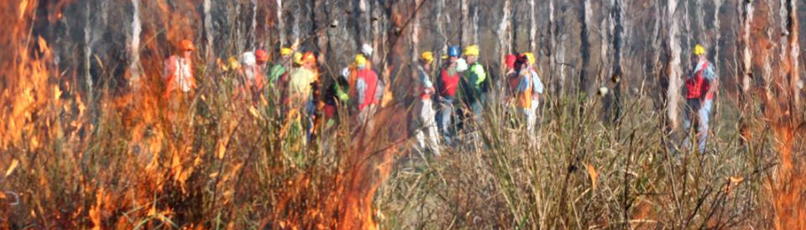
▌Prescribed burning for multiple objectives
A/Prof Tina Bell, University of Sydney
National Fire Fuels Science Webinar 13 May 2020
The science of hazard reduction: what do we know and what are the knowledge gaps?

Slide 2
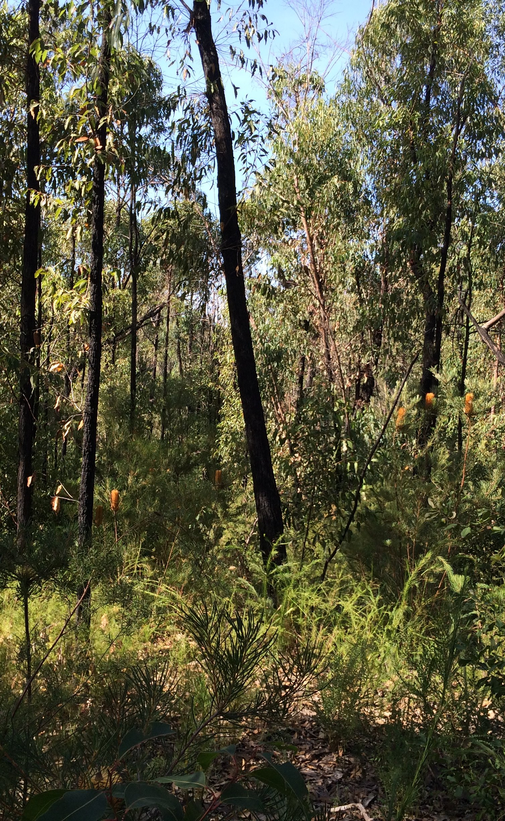
Forest cycling
Water cycle
Rainfall
Evapotranspiration
Living
biomass
Interception
Evaporation
Drainage
and run off
Litter
Soil water

Slide 3
Forest cycling
Water cycle
Carbon cycle
Rainfall
Evapotranspiration
Plant
growth
Living
biomass
CO₂
Interception
Litter fall
Evaporation
Litter and soil decay (respiration)
Drainage
and run off
Litter
Soil organic carbon
Soil water
Soil carbon

Slide 4

Forest cycling
Water cycle
Carbon cycle
Planned/unplanned fire
Rainfall
Evapotranspiration
Plant
growth
Living
biomass
CO₂
Interception
Litter fall
Evaporation
Litter and soil decay (respiration)
Drainage
and run off
Litter
Soil organic carbon
Soil water
Soil carbon

Slide 5
Water cycling after a prescribed burn
Minimal effect on total evapotranspiration
  Major component of water balance
  Overstorey trees remain intact
Greater availability of soil moisture
  Growth of overstorey trees?
    Depends on tree age
    Rate of regrowth of understorey vegetation
  Deep drainage?
    Depends on soil properties
Variability across the landscape
Gharun et al. (2018) Science of the Total Environment 615, 1000–1009
Yu et al. (2020) BNH CRC Technical Report

Slide 6
Carbon cycling after a prescribed burn
Minimal effect on carbon in overstorey trees and soil
  Overstorey trees remain intact (25-350 t C ha⁻¹)
  Soil carbon generally unaffected (125-270 t C ha⁻¹)
Redistribution of carbon pools
  Released to the atmosphere as CO₂ (20-139 t C ha⁻¹)
    Most carbon loss from litter (3-10 t C ha⁻¹) and coarse woody debris (1-35 t C ha⁻¹)
    Smaller losses from understorey vegetation (1-7 t C ha⁻¹)
  Conversion to charcoal and ash: 3-5%
  Most of the gains of carbon after 1 year due to re-accumulation of litter
  Growth of overstorey trees and understorey vegetation?
Variability across the landscape
Possell et al. (2015) Biogeosciences 12, 257–268
Jenkins et al. (2016) Forest Ecology and Management 373, 9-16
Pepper et al. (unpublished data)

Slide 7
Multiples objectives, multiple fires?
] (2%)
] (7%)
] (2%)
Peer-reviewed publications in last 10 years
Data source
  Field study (53%) vs Synthesis (42%)
Fire regime
  Single fire (35%) vs Multiple fires (57%)
Focus
  Water (6%)
  Carbon (9%)
  Soil (17%)
  Flora (26%)
  Fauna (31%)

