Slide 1
▌Prescribed burning: a south-west Australian perspective
Dr Neil Burrows, FireNinti Consultancy
National Fire Fuels Science Webinar 13 May 2020
The science of hazard reduction: what do we know and what are the knowledge gaps?

Slide 2
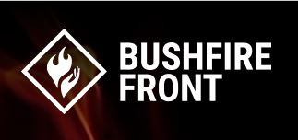
Prescribed burning: A south-west Australian perspective Neil Burrows Bushfire Front Western Australia
Landscape prescribed burning, done properly, is critical to significantly reducing bushfire losses and increasing bushfire ‘saves’
It is “fire by choice, not by chance” (Pyne 2020)

Slide 3
The science
Regular prescribed burning:
Reduces fuel load
Reduces fuel hazard by altering fuel structure
This reduces:
Fire intensity
Rate of spread
Flame size
Ember attack and spotting
Outcomes:
Suppression is easier, safer, cheaper
Saves lives
Less damage to communities and the environment

Slide 4
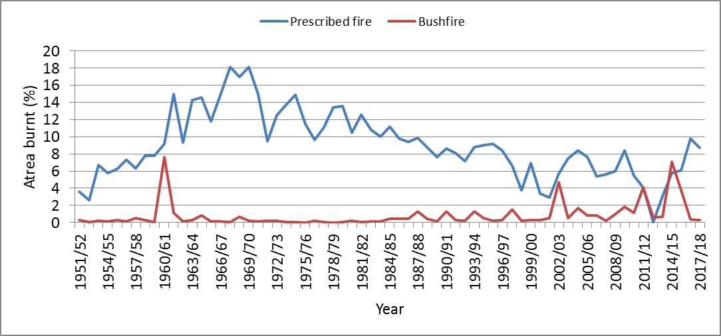
SW Forest region (~2.5 M ha)
The history
When the area burnt by prescribe fire trends down, the area burnt by bushfire trends up
We need to burn at least 8% per annum to ‘flatten the curve’.
Prescribed burning area (single year) and bushfire area (mean of next 5 years). (Source: Sneeuwjagt 2008/11 + updates)

Slide 5
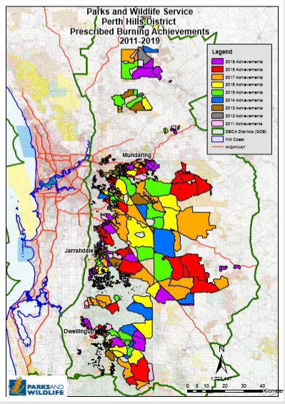
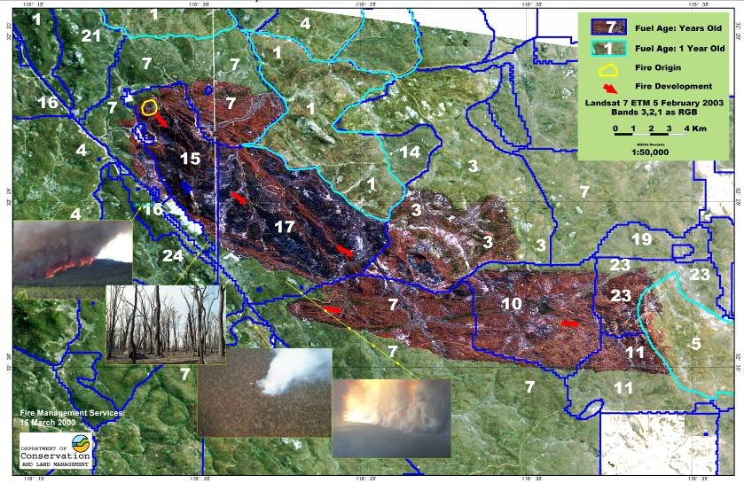
The experience
Prescribed burning greatly assists our fire fighters:
Published case studies
Fire fighter experiences

Slide 6
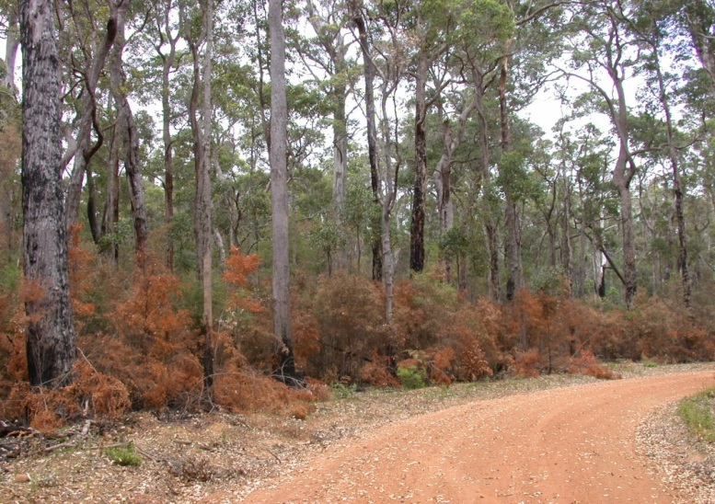
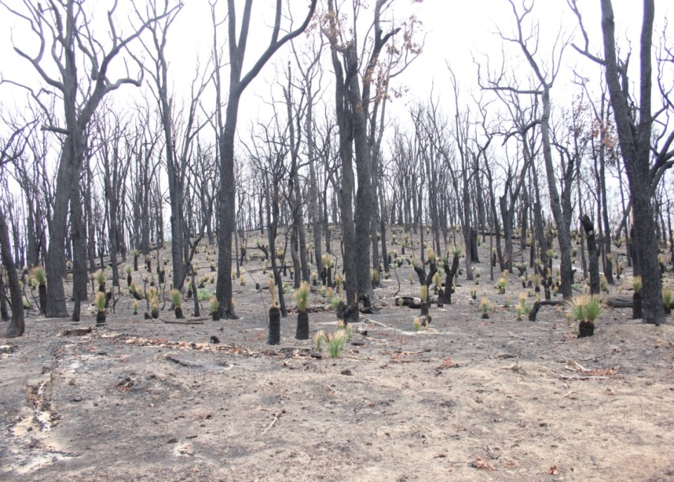
Biodiversity and the environment
After 60 years, no evidence of environmental damage or species declines or extinctions
Very low burn severity and killing power (<500 kW/m)
Patchy in all dimensions, diverse seral stages
‘Fire sensitive’ species persist by surviving or escaping the flames
Recovers quickly (in years)
A mega-bushfire cycle causes environmental harm and threatens our wildlife and our communities
Very high burn severity and killing power (20,000-30,000 kW/m)
Homogenous over large areas
Few survivors and few escapees
Recovers slowly (in decades or centuries)

Slide 7
Impediments to prescribed burning can be managed by:
Strong leadership
Competent, well resourced people
Good science and innovation
Community education and information
Implemented in an adaptive, risk management framework
Since the 1961 Royal Commission, prescribed burning in SW WA has had strong support from the major political parties, and broad community support, with the usual opposition from green groups and green academics.
“The McGowan government is delivering a $22 M funding boost to DBCA’s Enhanced Prescribed Burning Program over the next four years. This is in addition to the Department’s $11 M annual budget for the south west of the State”.
The Hon Stephen Dawson, Minister for Environment Oct. 2019.

